Slide 1
EPM @ EPA
Giving change a chance – Enterprise Project Management @ EPA

Slide 2
EPM @ EPA
Disclaimer:
This presentation contains the personal views of the presenter and is not an official representation of Environmental Protection Agency policies, practices, or viewpoints.
Giving change a chance – Enterprise Project Management @ EPA

Slide 3
Introduction – Richard L. Warren
21-year Navy career
18-years in the private sector
Demoed Microsoft Merchant Server onstage with Bill Gates for its launch (now Commerce Server 2009)
Several CIO, CTO, and CSO roles with manufacturing and technology sector companies
Founded Judd’s Online
Launched Martha Stewart, Reba McEntire, Ford Motor Company, American Diabetes Association, many others
Joined EPA in 2009
PMP, MBA E-Business
PhD candidate in IT specializing in Project Management
MCITP in EPM with Project Server 2007
Focused on helping the public sector improve IT project outcomes that directly impact change and transparency
http://richardlwarren.info

Slide 4
Survey 1
What sector are you in?
Public sector
Manufacturing
Retail
Technology
Services
Academic
Other

Slide 5
Survey 2
Do you pay taxes?
Yes
No
No (and send my email address to the IRS…;-)

Slide 6
EPM Background @ EPA
No agency-wide EPM context
Office of Water commissioned a maturity assessment in 2007
Robbins Gioia conducted the survey and assessment
Not favorable
Not favorably received
Led to the formation of a PMO for OW in 2008

Slide 7
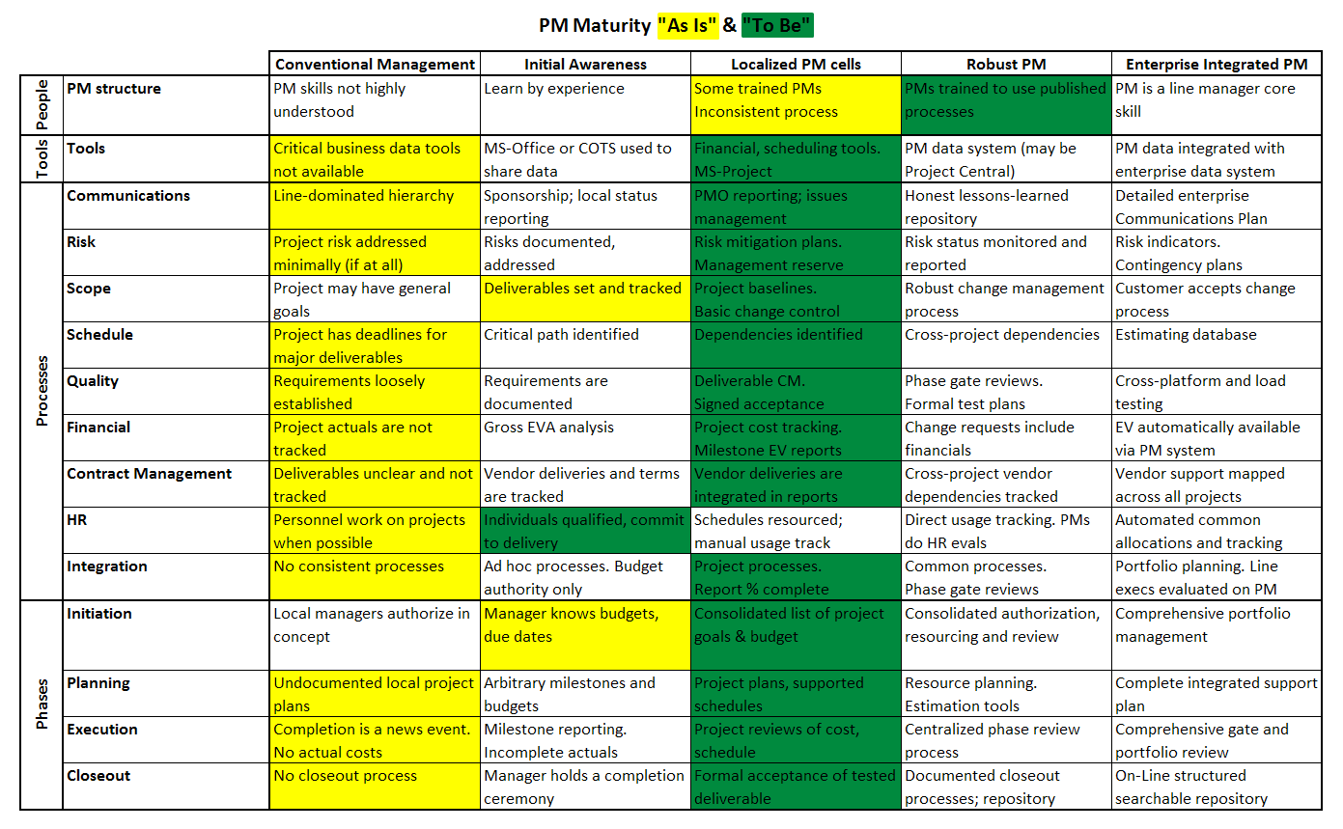
EPM Background @ EPA
No agency-wide EPM context
Office of Water commissioned a maturity assessment in 2007
Robbins Gioia conducted the survey and assessment
Not favorable
Not favorably received
Led to the formation of a PMO for OW in 2008

Slide 8
EPM Background @ EPA
Still no agency-wide PMO or EPM initiative
Only 2 of the 15 EPA “offices” have a PMO
Only tools have been Project Professional 2003/2007
Spotty implementation of less than 12 copies within the Office of Water
Inconsistent usage with little formal training on the product
Low PMP certification % – even within the PMO

Slide 9
Public sector drivers…
Desire for transparency
Bipartisan desire to make governance visible to public, Administration, and Congress
Mandate for accountability
Office of Management & Budget, Federal CIO
“More than half of all major IT projects funded in FY08 ($25.2B) are poorly planned, performing poorly, or both. That’s more than 35% of the federal IT budget.”
Applying Standish Group CHAOS 2009 figures:
Only $8.1B of that investment succeeds
Fully $11.1B is either late, over budget and/or less than optimally functional
A miserable $6B is wasted altogether (failures except for lessons-learned)
Marginal improvement in ‘at risk’ fraction of $17.2B per year is possible with EPM

Slide 10
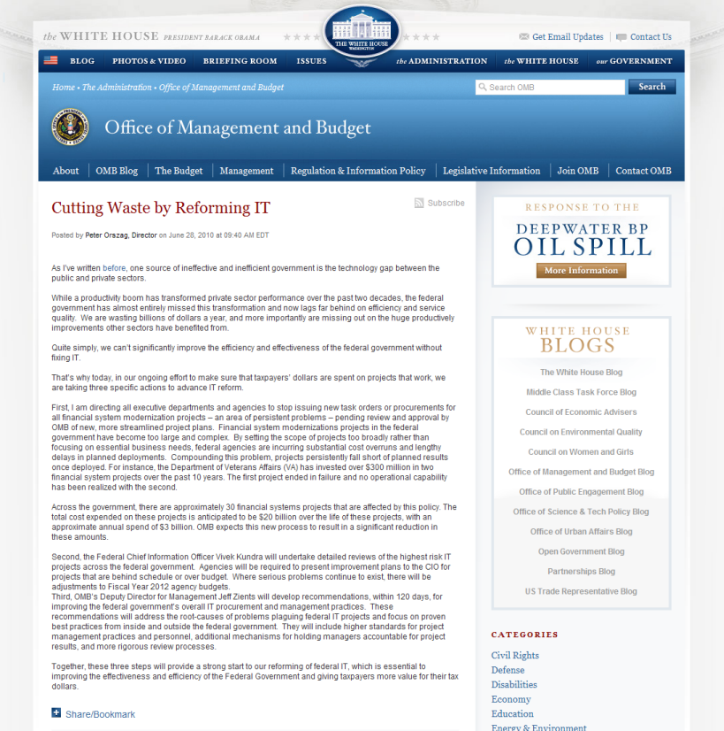
Driver trendlines…
Increasing scrutiny
OMB focus on cutting waste is focused on PM practices and personnel
120-day window for improvement recommen-dations expires in just 7 days – 10/26/2010

Slide 11
Driver trendlines…
Increasing scrutiny
OMB focus on cutting waste is focused on PM practices and personnel
120-day window for improvement recommen-dations expires in just 7 days – 10/26/2010

Slide 12
The path to EPM @ EPA
Critical elements of success:
Clearly defined goals and sufficient planning to achieve them
Executive sponsorship
Team readiness
Platform availability
Organizational tailoring & customization

Slide 13
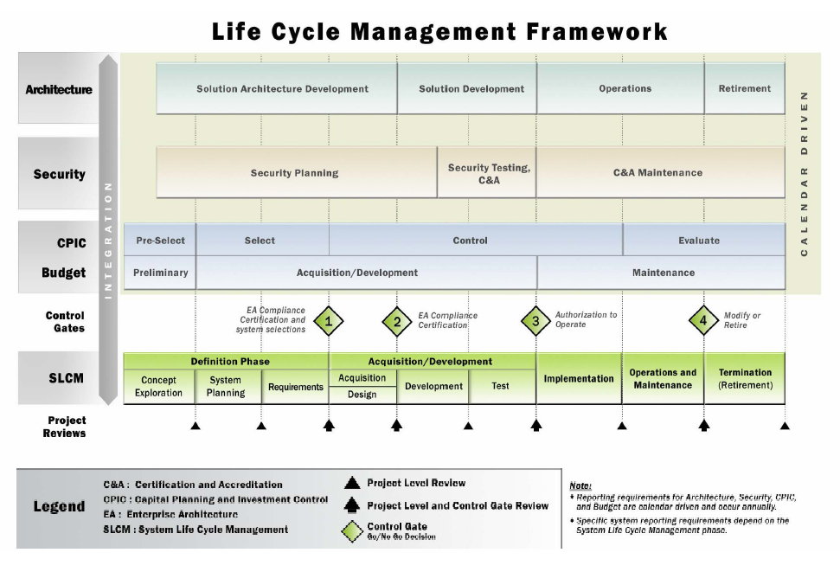
The path to EPM @ EPA
Establish agency standard
Propose a prototype that would eventually lead to a standard
Start-to-finish: 7 months
Architecture nobody liked
Didn’t integrate well with other enterprise choices (Oracle, Lotus Notes)
Used versions not yet approved for internal agency use (SQL Server 2008, SharePoint v.Anything, Windows Server 2008, SQL Server 2008, etc.)

Slide 14
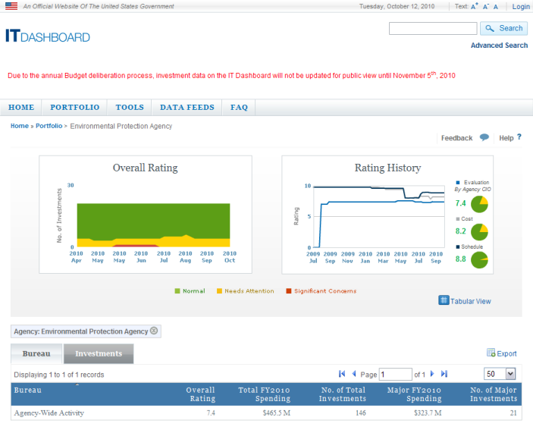
The path to EPM @ EPA
Executive buy-in
it.usaspending.gov
By agency/department
By investment
Use same metrics & measures – provide a “common view” irrespective of investment level
Believable?
IT Projects with 17-year schedules and budgets?
Heat or Light?

Slide 15
Survey 3
What factor will be most effective for you executive team?
See the light
Feel the heat
Both
Neither
Other
Dilbert scenario (oblivious)

Slide 16
The path to EPM @ EPA
Team readiness
PM basics
Mulcahy PMP Exam prep (6th ed.)
Project & Project Server training
MSProjectExperts
5-day course (28 PDU’s for the few PMP’s we have…;-)
Very hands-on
Hampered by lack of their 2010 book on Project Server

Slide 17
The path to EPM @ EPA
Team readiness
PM basics
Mulcahy PMP Exam prep (6th ed.)
Project & Project Server training
MSProjectExperts
5-day course (28 PDU’s for the few PMP’s we have…;-)
Very hands-on
Hampered by lack of their 2010 book on Project Server

Slide 18
The path to EPM @ EPA
SaaS as an accelerator
Early TAP exposure
Hosted at ProjectHosts.com
Prototyped in the Release Candidate
First Project Server 2010 customer – more than a little unusual for the public sector
Three instances (Landman model)
Development, Training, and Production
Security-ready (FISMA)
Already in use for two months before the “approval” for the prototype was granted…we all have our schedules…

Slide 19
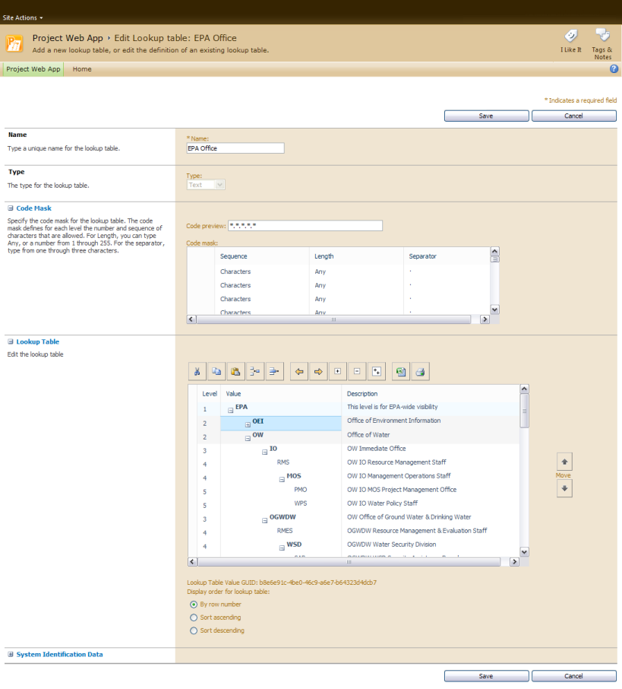
The path to EPM @ EPA
Organizational tailoring & customization
EPA-specific organization
EPA-specific SDLC implemented as project templates tailored to investment level
EPA- and Office-specific site provisioning
Generic EPA project sites
Office of Water project sites
Driven by investment level

Slide 20
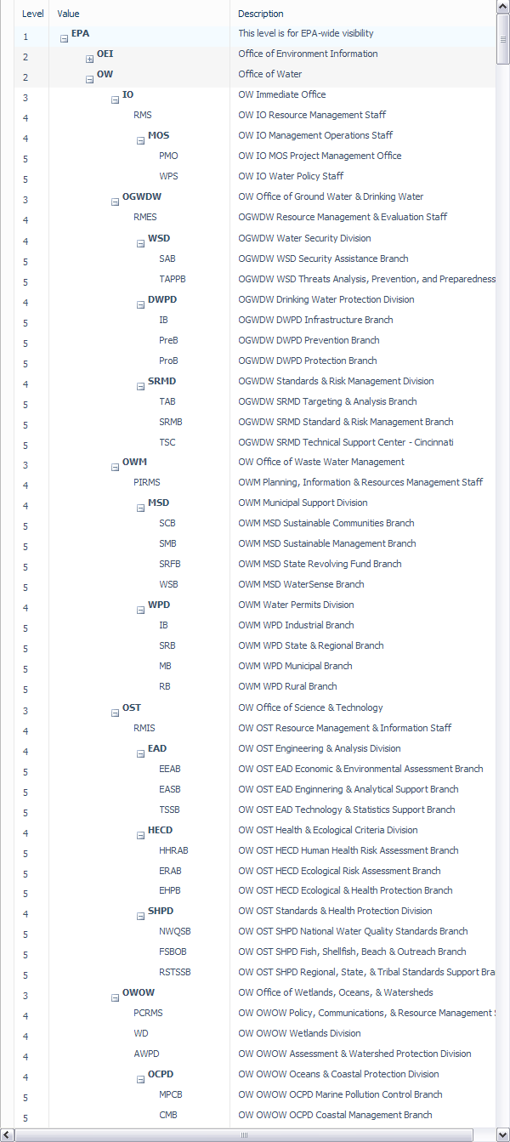
The path to EPM @ EPA
Organizational tailoring & customization
EPA-specific organization
EPA-specific SDLC implemented as project templates tailored to investment level
EPA- and Office-specific site provisioning
Generic EPA project sites
Office of Water project sites
Driven by investment level

Slide 21
The path to EPM @ EPA
Organizational tailoring & customization
EPA-specific organization
EPA-specific SDLC implemented as project templates tailored to investment level
EPA- and Office-specific site provisioning
Generic EPA project sites
Office of Water project sites
Driven by investment level

Slide 22
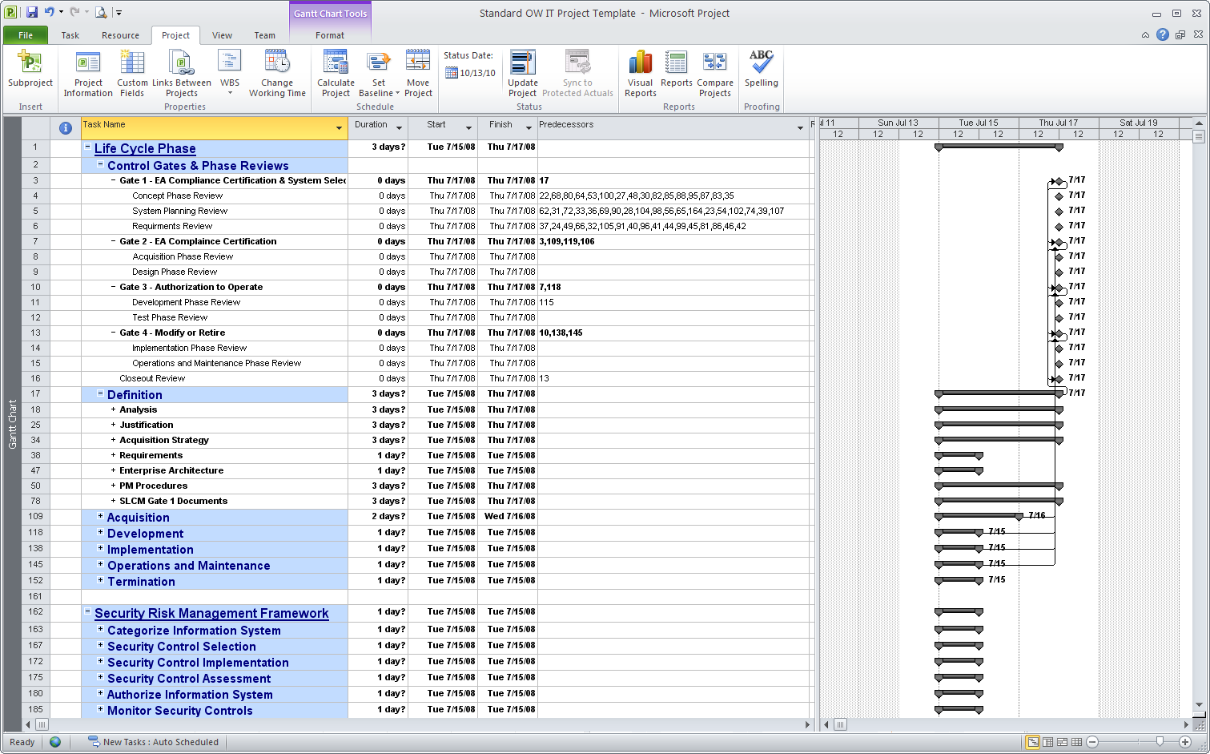
The path to EPM @ EPA
Organizational tailoring & customization
EPA-specific organization
EPA-specific SDLC implemented as project templates tailored to investment level
EPA- and Office-specific site provisioning
Generic EPA project sites
Office of Water project sites
Driven by investment level

Slide 23
The path to EPM @ EPA
Organizational tailoring & customization
EPA-specific organization
EPA-specific SDLC implemented as project templates tailored to investment level
EPA- and Office-specific site provisioning (ongoing)
Generic EPA project sites
Office of Water project sites
Driven by investment level

Slide 24
The path to EPM @ EPA
Barriers
Enterprise architecture
Heavy organizational enterprise relationship with Oracle favors Primavera, but only at the platform level (not at the PM practitioner, executive, or participant levels)
Unwillingness to federate AD to provide ESSO and ease firewall rule restrictions for remote desktop access to hosted solutions
Strong anti-Microsoft bias and very slow technology adoption process/schedule
Lotus Notes for messaging lacks both Sharepoint awareness and calendar/task updating
Just now upgrading to Office 2007 on the desktop, still running XP SP3
Product shortcomings
Excel services in a hosted environment cannot provide direct database connectivity (OLAP, yes, database, no)
Only workarounds are to not use SSRS or have remote desktop access
Doesn’t impact local installations of Project Server 2010, just SaaS implementations

Slide 25
EPM @ EPA Next Steps
Entrenchment
With the initial round of training complete, foster daily usage to entrench learning and best practice adoption
Extension
Extend our use of Project Server to contractors through sub-projects (which is where our SaaS strategy really pays off by not having them inside the WAN)
Expand the community of users upward to managers and executives who will discover ease of use and consistency with broader federal project management standards and grading criteria
Integration
Begin to offer linkages between IT.USASpending.gov and public views of the projects upon which their data is based – full drill-down support
Produce XML feeds needed by IT.USASpending.gov as reports from Project Server to begin with

Slide 26
Prescriptive guidance…
First things first
Tackle current-project PM first
Tackle investment selection either as a follow-on or with a separate effort
Use the customization/tailoring process as a discussion enabler for low-maturity adopters
Provides a constrained framework for process-focused discussions
Allows strategic discussions to evolve from the tactical, bottom-up customization discussions
Try before you buy
Excellent risk mitigation strategy for companies and organizations that may not be ready to make an investment plunge but need to get started on the path to EPM (and just don’t yet know it…;-)

Slide 27
Recommended reading…
Public-Sector Project Management
David W. Wirick
ISBN: 978-0-470-48731

Slide 28
Recommended reading…
Public-Sector Project Management
David W. Wirick
ISBN: 978-0-470-48731
Researching the Value of Project Management
Janice Thomas, PhD
Mark Mullaly, PMP
ISBN: 978-1-933890-49-4

Slide 29
Recommended reading…
Public-Sector Project Management
David W. Wirick
ISBN: 978-0-470-48731
Researching the Value of Project Management
Janice Thomas, PhD
Mark Mullaly, PMP
ISBN: 978-1-933890-49-4
Managing Public Sector Projects
David S. Kassel
ISBN: 978-1420088731

Slide 30
Questions?
EPM @ EPA

