Slide 1
Expedite Project Updates Using a Custom Status View
June 20, 2018 @ 12pm-1pm EST
Presented By:
Walter M. Stinnett, Jr., PMP, CSM, MCTS
800.556.2506 | www.EdwPS.com
Notes:
Start Recording
We are going to go ahead and get started with todays session on xxxxx.

Slide 2
Objectives
Describe the importance of monitoring and controlling projects
Discuss why communication is key to successful projects
Define the schedule control process and the importance of accurate status
Create a custom status view to expedite project updates

Slide 3
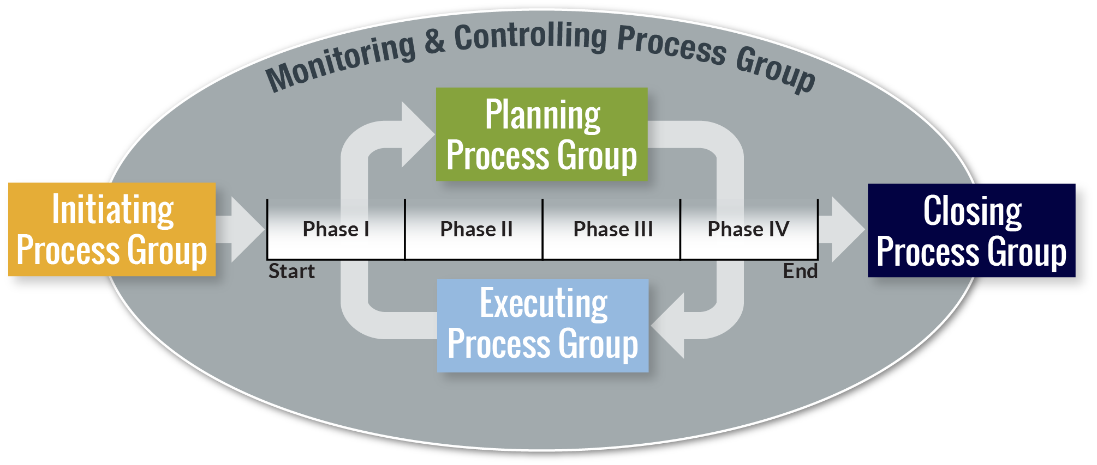
Five Project Management Processes
Initiating
Planning
Executing
Monitoring and Controlling
Closing
Graphic adapted from Project Management Institute, A Guide to the Project Management Body of Knowledge, (PMBOK® Guide) –Sixth Edition, Project Management Institute Inc., 2017, Page 23

Slide 4
Monitoring and Controlling Process
Track, review, and regulate project progress and performance
Identify any required plan changes
Initiate corresponding changes
Definitions from the Project Management Institute, A Guide to the Project Management Body of Knowledge, (PMBOK® Guide) – Sixth Edition, Project Management Institute Inc., 2017

Slide 5
Project Schedule Management Knowledge Area
(4)
(5)
(6)
Project Schedule
Management
(7)
(8)
(9)
Project Resource
Management
(10)
(11)
(12)
(13)
Processes required to ensure timely project completion
Plan Schedule Management
Define Activities
Sequence Activities
Estimate Activity Durations
Develop Schedule
Control Schedule
Project Management Institute, A Guide to the Project Management Body of Knowledge, (PMBOK® Guide) – Sixth Edition, Project Management Institute Inc., 2017, Pages 24-25

Slide 6
Why Use a Schedule Tool?
Why develop a detailed project work schedule?
Communication (between you and your stakeholder/customer/client)
Communication (between you and your project team)
Communication (between you and your senior management)
Why use a scheduling tool like Microsoft Project?
Calculate and display project task dates
Calculate and display use of resources
Assist in managing the schedule once developed
Scheduling tools do NOT build a schedule
Calculate the project critical path
Track and communicate progress
Set up and examine “What if” scenarios

Slide 7
Control the Schedule
Controlling (or status updating) the project schedule involves
Determining schedule changes
Managing the actual changes, as they occur
To determine and manage project schedule changes, you must track the actual project progress against the original project plan (schedule baseline)

Slide 8
Information Needed to Track Progress
Availability for each resource
Was the resource available, as planned, during the status period?
Is the resource going to be available, as planned, moving forward (to your knowledge)?
Task schedule for each task
If the task started, when did task work begin (Actual Start)?
If the task is complete, when did it finish (Actual Finish)?
If the task is not complete
How much calendar time (typically days or hours) has been spent on the task?
How much more calendar time is needed?
Task cost for each resource, on each task
How much work was expended on the task by the resource?
How much work is needed, by each resource, to complete the work?

Slide 9
Create a Custom Status View
Combines a task detail form with a task usage view, allowing updates in one view
Actual start and finish
Actual and remaining work
Duration
Percentage complete
Resource assignments

Slide 10
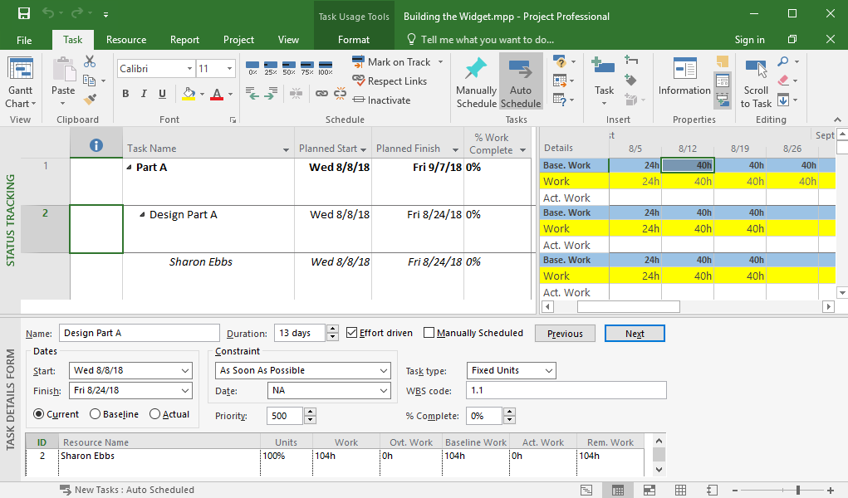
Custom Status View

Slide 11
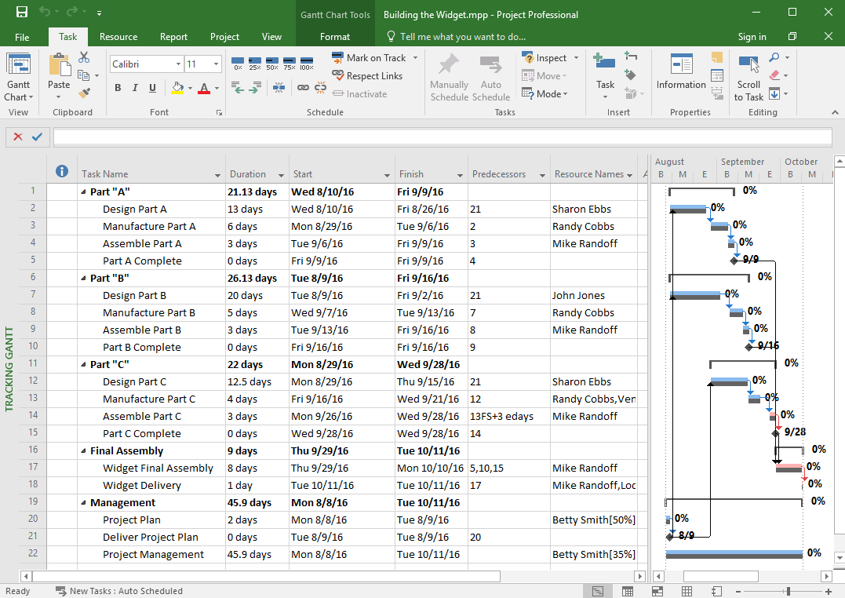
Our Project

Slide 12
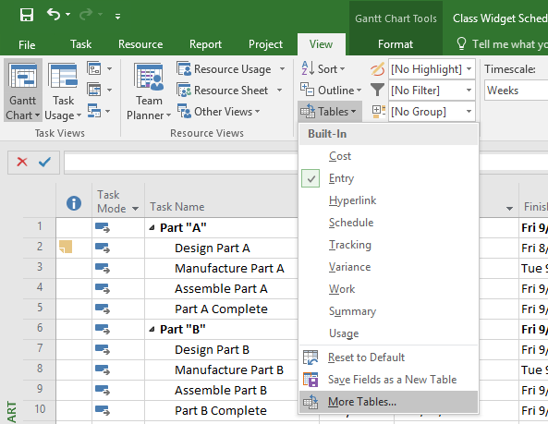
Create Base Custom Table
Step 1: Select the View tab
Step 2: Select More Tables from the Tables dropdown
Step 1: Select the View tab
Step 2: Select More Tables from the Tables dropdown

Slide 13
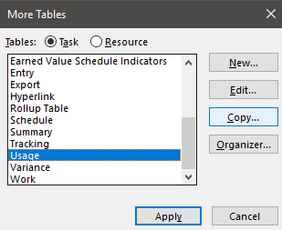
Create Base Custom Table
Step 3: Select the Task radio button for table type
Step 4: Select the default Usage table from the list and click Copy
Step 3: Select the Task radio button for table type
Step 4: Select the default Usage table from the list and click Copy

Slide 14
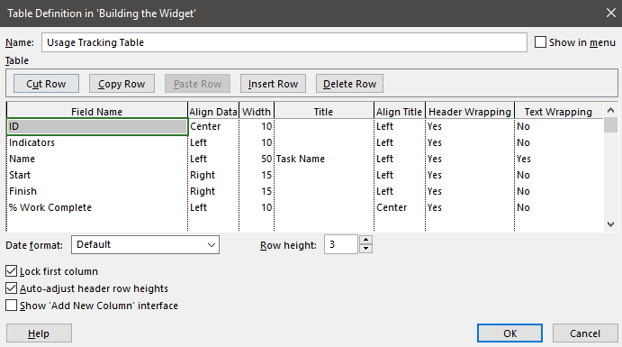
Create Base Custom Table
Step 5: Rename the table
Step 6: Modify the fields and adjust the formatting, if needed
Step 7: Click OK and to close Table Definition dialog
Step 8: Click Cancel to close More Tables dialog
Step 5: Rename the table
Step 6: Modify the fields and adjust the formatting, if needed
Step 7: Click OK and to close Table Definition dialog
Step 8: Click Cancel to close More Tables dialog

Slide 15
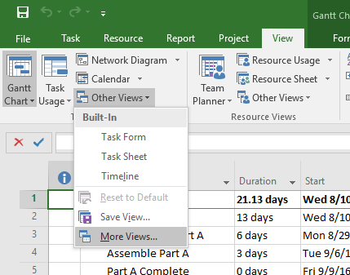
Create Primary Custom View
Step 9: Select the View tab
Step 10: Select More Views from the Other Views dropdown from the Task Views group
Step 9: Select the View tab
Step 10: Select More Views from the Other Views dropdown from the Task Views group

Slide 16
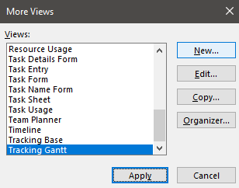
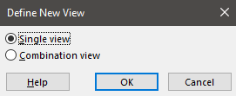
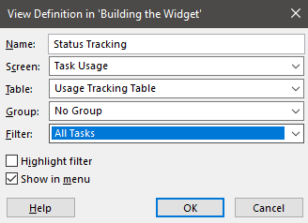
Create Primary Custom View
Step 11: Select the New button in the More Views dialog
Step 12: Select the Single view radio button in Define New View
Step 13: Select the following in the View Definition dialog
Name: Enter name of new view
Screen: Task Usage
Table: Select the new custom table
Group: No Group
Filter: All Tasks
Step 13
Step 11
Step 12

Slide 17
Create the Custom Status View
Step 14: Select the View tab
Step 15: Select More Views from the Other Views dropdown from the Task Views group
Step 14: Select the View tab
Step 15: Select More Views from the Other Views dropdown from the Task Views group

Slide 18
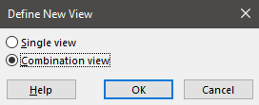
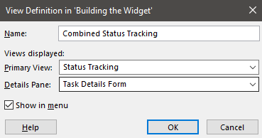
Create Primary Custom View
Step 16: Select the New button in the More Views dialog
Step 17: Select the Combination view radio button in the Define New View dialog
Step 18: Select or enter the following in the View Definition dialog
Name: Enter name of new view
Primary View: Select the just created single view
Details Pane: Task Details Form
Step 16
Step 17
Step 18

Slide 19
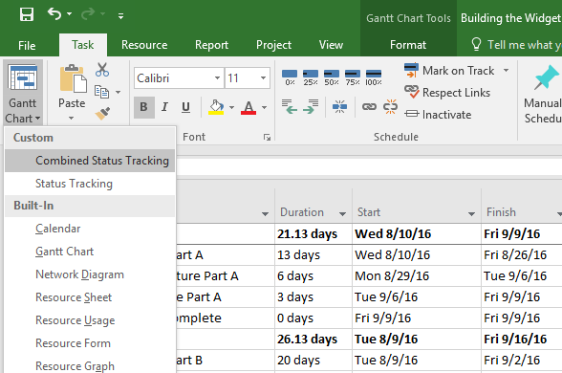
Display Custom Status View
Step 19: Select the Task tab
Step 20: Select Combined Status Tracking from the Gantt Chart dropdown from the Task Views group
Step 19: Select the Tab tab
Step 20: Select Combined Status Tracking from the Gantt Chart dropdown from the Task Views group

Slide 20
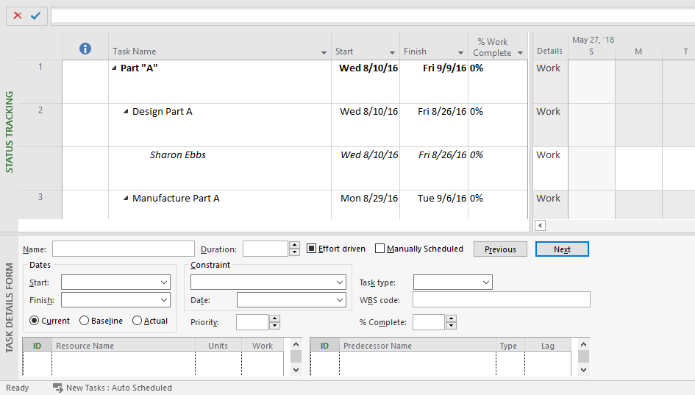
Custom Status View
Step 9: Select the View tab
Step 10: Select More Views from the Other Views dropdown from the Task Views group

Slide 21
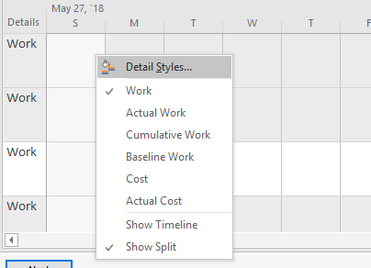
Modify Format of Task Usage Panel
Step 1: Right click anywhere in the task usage panel and select Detail Styles
Step 1: Right click anywhere in the task usage panel and select Detail Styles

Slide 22
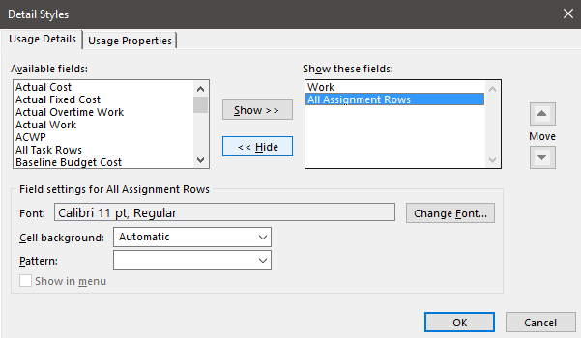
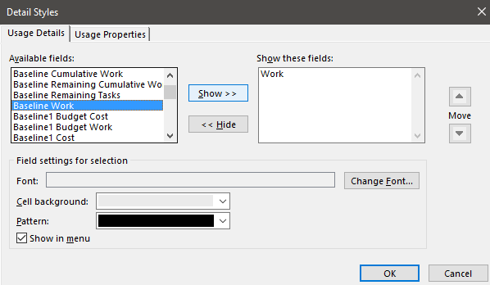
Add Fields to Task Usage View
Step 2: Select All Assignment Rows in the Show these fields list and click Hide to remove it from the view
Step 3: Select Baseline Work and Actual Work in the Available fields list and click Show to add them to the view
Step 2: Select All Assignment Rows in the Show these fields list and click Hide to remove it from the view
Step 3: Select Baseline Work and Actual Work in the Available fields list and click Show to add them to the view

Slide 23
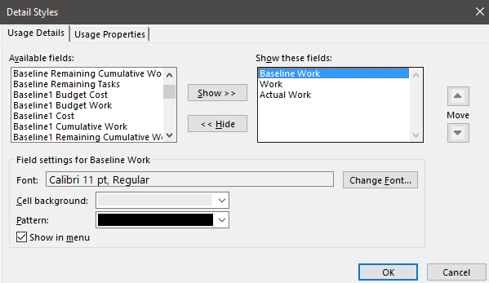
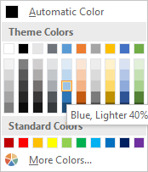
Modify Field Order and Cell Background Color
Step 4: Select Baseline Work in the Show these fields list and click the up Move arrow to move it to the top of the list
Step 5: Select Baseline Work, Work, and Actual Work fields in order and assign each a different cell color
Step 4: Select Baseline Work in the Show these fields list and click the up Move arrow to move it to the top of the list
Step 5: Select Baseline Work, Work, and Actual Work fields in order and assign each a different cell color

Slide 24
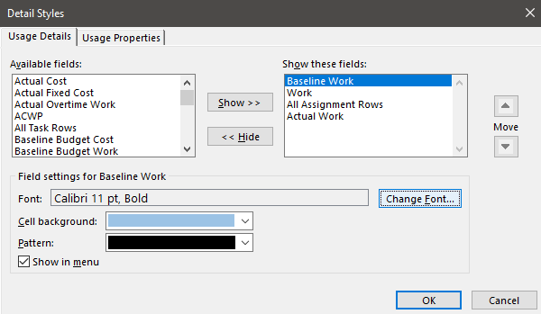
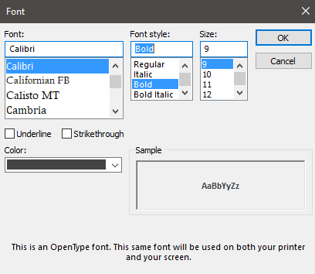
Change the Font Style of Fields
Step 6: Select fields in order and click the Change Font button to modify font and/or font style
Step 6: Select fields in order and click the Change Font button to modify font and/or font style

Slide 25
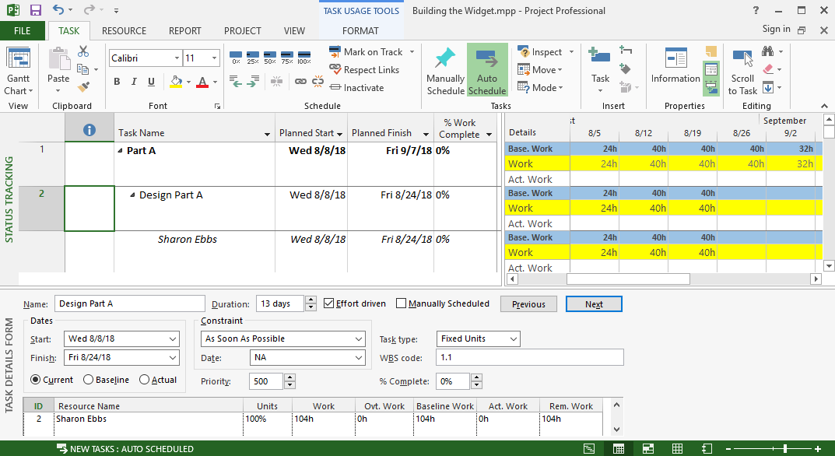
Completed Custom Status View
Save file as a .mpt project template or copy into other project schedules via the Organizer

Slide 26
Questions?

Slide 27
Thank You!
Presented By:
Walter M. Stinnett, Jr., PMP, CSM, MCTS
WStinnett@EdwPS.com
800.556.2506 | www.EdwPS.com
Notes:
Start Recording
We are going to go ahead and get started with todays session on xxxxx.

