Slide 1
Data Analysis using Project with Excel
November 28, 2018 @ 12pm-1pm EST Jeff Bongiovani
Notes:
Start Recording
We are going to go ahead and get started with todays session on xxxxx.

Slide 2
Topic Outline
General Information
Database and Analysis Concepts
Adapting Microsoft Project
Microsoft Excel Analysis

Slide 3
Intentions
Understand how to manage data in Microsoft Project intended for an ongoing data collection in Microsoft Excel
Understand how View, Tables, and Fields in Microsoft Project can be customized to enable this process
Understand how to maintain an ongoing data collection in Excel for the purposes of analysis

Slide 4
Disclaimer
Requires a relatively advanced understanding of Project features
Only an overview of
Project Views, Tables, and Custom Fields
Excel Tables, Functions, and PivotTables
You may not find use in the overall process and example, but there may be tips and techniques that may help

Slide 5
Background Information
IT Instructor for 12 years
Employed with State of Maryland for 2 years
IT Instructor again for 3 years
Instructional Designer for 7 months

Slide 6
Database Concepts

Slide 7
The Relational Database
Typically represents a central transaction or activity that involves relevant people, places, objects, and classifications
Each grouping of people, places, objects, classifications, and activities is stored within separate tables
Each table contains a primary key unique identifier
Each table contains relevant attributes for those entities uniquely identified
Unique information is stored only one time
Tables reference the unique identifiers of other tables with which they are associated
Customers
Orders
Products
Order Line Items

Slide 8
Table Relationships
Parent to Child or One to Many
Several customers may place orders over time
A single customer could return multiple times
Only one customer name appears on the order
Every time that same customer places an order, we refer to that customer by the same identifier
Customers
A – Mike
B – Judy
C – Pat
Orders
Products
1001 - A
1002 - B
1003 - A
Order Line Items

Slide 9
Join or Junction Relationships
Many for Many
For each order, multiple products are purchased
A single product could be sold multiple times
By its title (i.e. not one specific jar of jam, but a name referring to the brand, type, and size of jam)
The Order Number cannot be repeated in its table; the Product ID cannot be repeated in its table
Customers
Orders
Products
1001 - A
1002 - B
1003 - A
Order Line Items
Wine
Cheese
Pickles
1001 - Wine
1001 - Cheese
1002 - Cheese
1002 - Pickles
1003 - Wine

Slide 10
Potential Analysis
Customers is connected to Orders
Count the number of times a customer placed orders
Count the number of customers within each month and show full name
Orders is connected to Order Line Items
Sum each order total
Customers, by means of Orders, is connected to Order Line Items
Analyze customer purchasing preferences
How often, what to they buy, how much to they buy at a time?
Customers
A – Mike
B – Judy
C – Pat
Orders
Products
1001 - A
1002 - B
1003 - A
Order Line Items
Wine
Cheese
Pickles
1001 - Wine
1001 - Cheese
1002 - Cheese
1002 - Pickles
1003 - Wine

Slide 11
Grouping and Aggregate Formulas
Orders
Order | Customer | Date
1001 | A | 1/1/2019
1002 | B | 1/6/2019
1003 | A | 1/11/2019
1004 | C | 1/16/2019
1005 | A | 1/21/2019
1006 | D | 1/26/2019
1007 | F | 1/31/2019
1008 | E | 2/5/2019
1009 | A | 2/10/2019
1010 | C | 2/15/2019
1011 | A | 2/20/2019
Customers | Jan 2019 | Feb 2019 | Total
Mike | 3 | 2 | 5
Judy | 1 |  | 1
Pat | 1 | 1 | 2
Jimmy | 1 |  | 1
Heather |  | 1 | 1
Francine | 1 |  | 1
Total | 7 | 4 | 11
Customers
A – Mike
B – Judy
C – Pat
Orders
Products
1001 - A
1002 - B
1003 - A
Order Line Items
Wine
Cheese
Pickles
1001 - Wine
1001 - Cheese
1002 - Cheese
1002 - Pickles
1003 - Wine

Slide 12
Each Project is a Database
Multiple tasks need to be performed
Multiple resources may be needed to perform those tasks
For each individual task, multiple resources may be assigned
Each resource may be assigned to multiple tasks
Tasks
Resources
Assignments

Slide 13
Project Views
Task Views
Gantt Chart
Task Sheet
Resource Views
Resource Sheet
Assignment Views
Task Usage
Resource Usage
Tasks
Resources
Assignments

Slide 14
Anatomy of Project Views
Single or Combination
Screen
Data Focus (i.e. Tasks, Resources, Assignments)
Chart, Detail Grid, or other Visual Display
Data Table (initial default)
Text Styles and Bar Styles
Other
Print Setup
Filter and Highlight
Timescale

Slide 15
The Project Table Concept
Queries or SQL Views
A collection of data columns represented by a useful name
EXISTING PROJECT TASK COLUMNS
THE ENTRY TABLE WHEN I’M USING THE GANTT CHART
% Complete
% Work Complete
Actual Cost
Actual Duration
Actual Work
Baseline Cost
Baseline Duration
Baseline Work
Cost
Duration
Finish Date
Name
Remaining Work
Start Date
Work
…20,000+ data fields
Indicators
Task Type
Name
Duration
Start Date
Finish Date
Predecessors
Resources

Slide 16
Existing Project Tables
Data will be relative to the current view
For example, if you open the Task Usage View and show the Cost Table, you will see current, baseline, actual cost data for assignments.
 | Current Expectation (Planned and Real) | Original Expectation (Baseline) | Actuals Comparisons
Durations Dates | Entry, Usage | Baseline | Tracking
Work | Usage, Work | Work, Baseline | Work, Tracking
Cost | Cost | Cost, Baseline | Cost, Tracking

Slide 17
Project Custom Fields
Text Columns
Number Columns and Calculations
CUSTOMIZABLE PROJECT TASK COLUMNS
THE CUSTOMIZED ENTRY TABLE PROVIDED FOR THE TEAM
Number1 (Total Cases)
Number2 (Remaining Cases)
Number3 (Cases Processed)
Number4 (Cases Per Hour Est)
Number5 (Estimated Hours)
Text1 (Branch Office)
Text2 (Project Name)
Text3 (Case Type)
Text4
Text5
Text6
Text7
Text8
…20,000+ data fields
Indicators
Task Type
Name
Duration
Start Date
Finish Date
Predecessors
Resources
Text1 (Branch Office)
Text2 (Project Name)
Text3 (Case Type)

Slide 18
Solution Example
Case Backlog Clearing
Running record of backlog projects performed for each Branch Office
Analysis of case types
Analysis of backlog recurrence
Projects
Tasks
Resources
Assignments
Branch Offices

Slide 19
Solution Limitations
No Microsoft Project Server
Data would not be imported into Microsoft Access
It would have found its way back into Excel anyway
No one on the team knows Microsoft Access
Existing Microsoft Project export options did not satisfy a simple process the team could perform
Export mapping
Visual reports
A shared template was easier to update and make accessible to the team than updating everyone’s Global.mpt
VBA (Visual Basic for Applications) wouldn’t be used in either Project or Excel

Slide 20
Importing Process
Custom table in Microsoft Project containing the same fields in a matching Excel Table
MICROSOFT PROJECT
Custom Table
Matching Excel Fields
Tasks
Project A
MICROSOFT EXCEL
Custom Table
Matching Excel Fields
Tasks
Project B
Projects
Custom Table
Matching Excel Fields
Tasks
Project C
Excel Table with Specific Fields
Custom Table
Matching Excel Fields
Tasks
Project D
Branch Offices
Custom Table
Matching Excel Fields
Tasks
Project E
Custom Table
Matching Excel Fields
Tasks
Project F

Slide 21
The Selected Solution
Customized Microsoft Project Template
Used to plan and track projects
Contains necessary reports for branch managers and directors on immediate project plan and status
Contains an easy export option after the project was completed
Microsoft Excel Data Collection
Contains all completed project tasks
Contains summary reports
By branch office
By case types

Slide 22
Adapting Microsoft Project

Slide 23
Fields for Analysis
Group By Fields
Data to Aggregate
Branch Office
Project Name
Case Type
Name (Task Name)
“Earlier Months”
“Previous Month”
“Current Month”
Case Month
Total Cases
Processing Hours

Slide 24
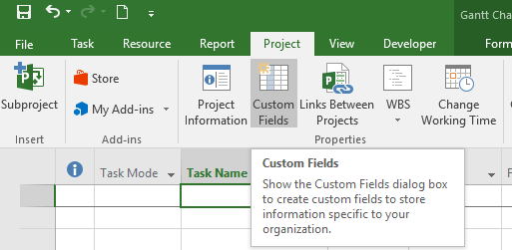
Creating Custom Fields
Text Fields
Branch Office
Project Name
Case Type
Number Fields
Total Cases
Remaining Cases
Cases Per Hour Est
Cases Processed (Calculated)
Estimated Remaining Hours (Calculated)
Date Field
Case Month

Slide 25
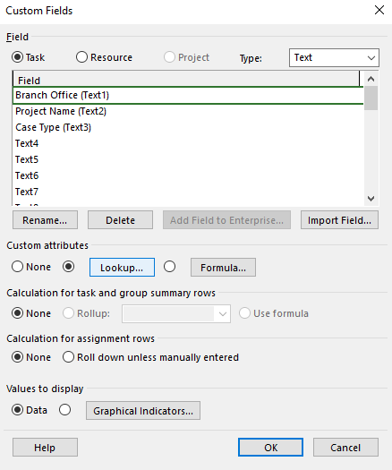
Creating Lookups
Enables Consistent Data Entry
Sorting
Filtering
PivotTables

Slide 26
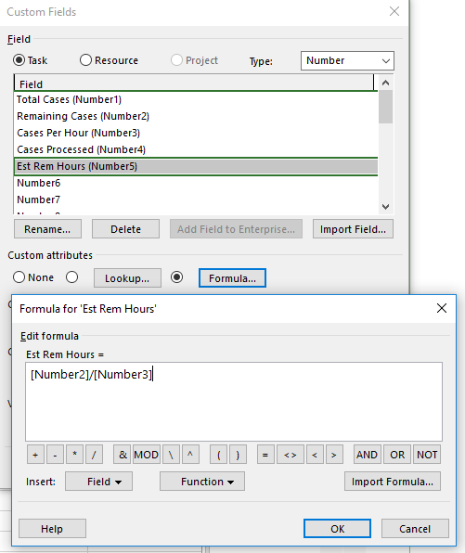
Calculated Fields
Cases Processed
Total Cases minus Remaining Cases
Manual input of Remaining
Est Remaining Hours
Remaining Cases divided by Cases Per Hour
Could not use VBA to update Project field Remaining Hours

Slide 27
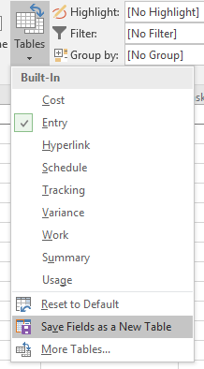
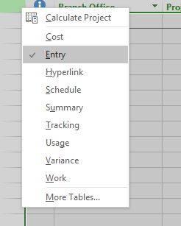
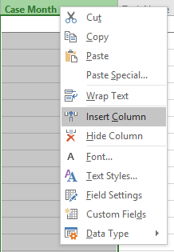
Customizing Tables
Select the pre-existing table with the fields you want to start with
Right-click column headings and insert the new columns you want
Right-click and remove the columns you don’t want
On the View Tab, select Tables and Save the Fields as a New Table
Select Reset to Default to reset the original table

Slide 28
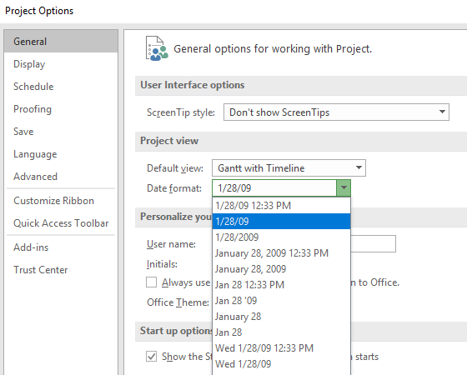
Date Formatting Options
The abbreviated name of the day of the week will translate into Excel as Text
Changing the Date Format to the short date format ensures Excel will read the pasted dates as dates

Slide 29
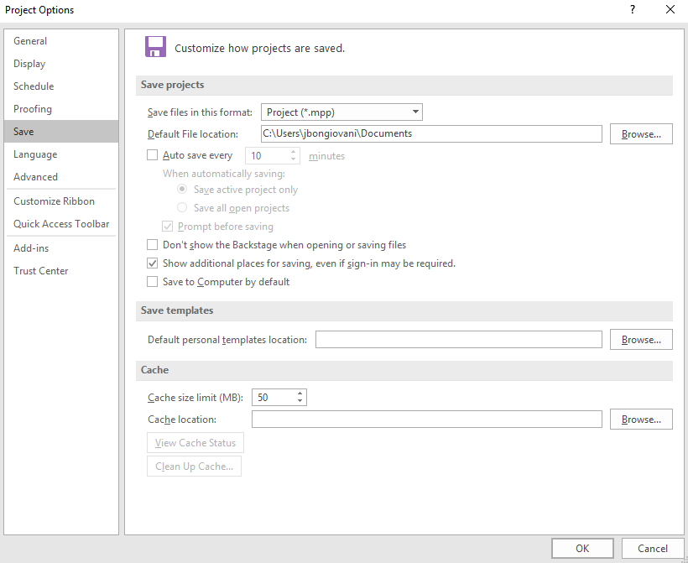
Shared Templates

Slide 30
The Custom Table

Slide 31
The Custom Table

Slide 32
Microsoft Excel Tables

Slide 33
Essential Excel Concepts
Excel is not a relational database
It can use formulas to reference unique identifiers in a related data collections
There is no enforced integrity
The table could be referencing an identifier that doesn’t exist
Data Validation is limited
There is no “true” enforcement of unique identifiers
The user must follow specific design methods for Excel to recognize that what they’ve created is a table

Slide 34
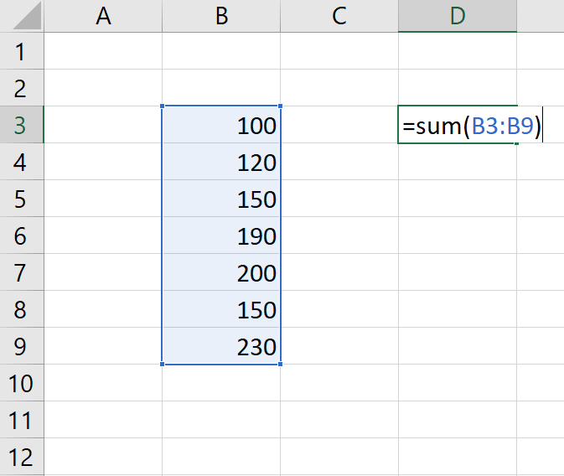
Cell References
Cell references in formulas should be used when the data being referenced will most likely remain unchanged
If the range expands, the user must update the function to include new cells

Slide 35
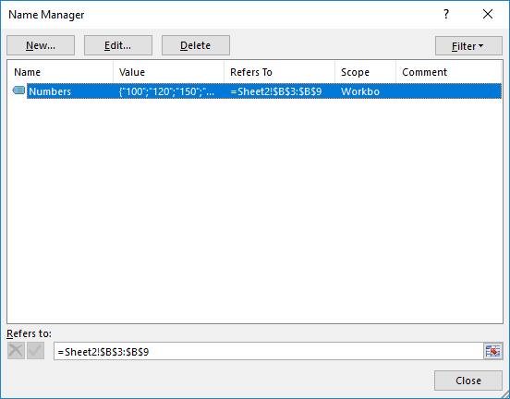
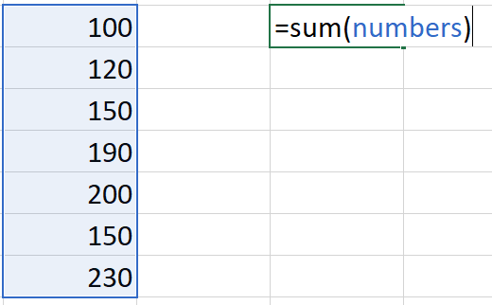
Named Ranges
If the same set of numbers is referenced several times, a proxy name can be created and used instead of the cells
If the list expands, the user can update the reference in the Name Manager and update all references to it

Slide 36
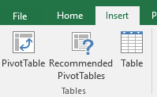
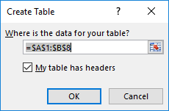
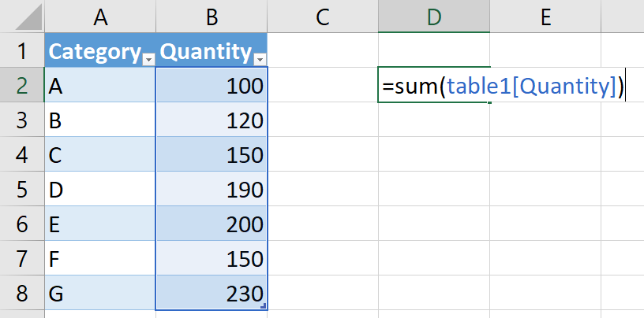
Data Tables
Added in version 2007
As the table expands, references to the table will recognize the new data
Formulas and PivotTables will not need to have their references updated

Slide 37
Needs for Proper Excel Tables
Begin the data table in cell A1
Data presentations created by PivotTables and PivotCharts are more print-worthy
Each column must have a column heading
Use a single row for column headings
Each column should contain data of one type only
Text
Dates (either it’s a date or it’s blank)
Numbers
Do not skip rows or columns within the list

Slide 38
Somewhat Simple Copy and Paste
With the exception of having to delete the column headings each time, the process is simple
Because the destination of the paste is defined as a table, all of the PivotTable reports only needed to be refreshed
Running a custom export map, opening the exported file, and pasting it into the Excel table was too many steps

Slide 39
Data Type Issues
Work and Duration Labels prevent any calculations

Slide 40
Excel Functions
=SUBSTITUTE(text to revise, text to replace, replacement text)
=SUBSTITUTE(“82 hrs”, “ hrs”, “”)
=VALUE(text that should and can be a number knowing this doesn’t remove letters and other stuff that’s preventing it from being one)
=VALUE(“82”)
=VALUE(SUBSTITUTE(L2,"hrs",""))

Slide 41
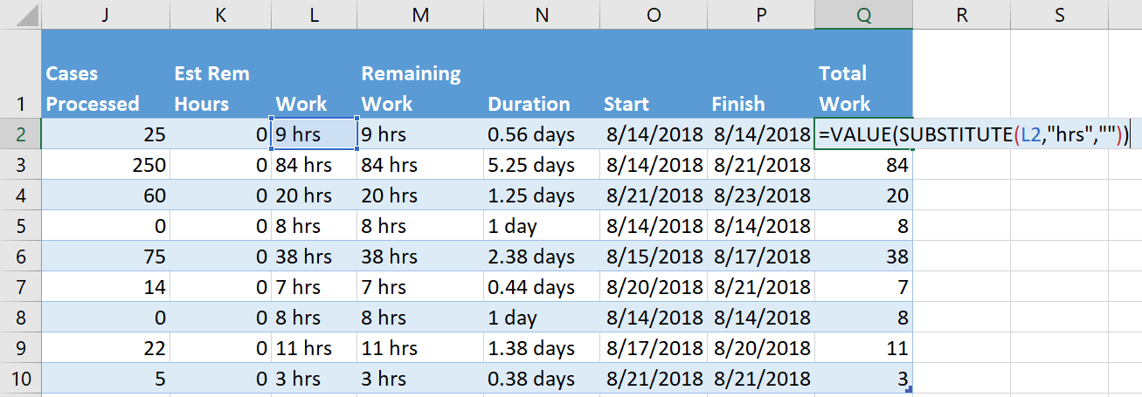
Best Strategies with Functions
Functions that fill automatically in data tables
Columns Pasting New Data Into

Slide 42
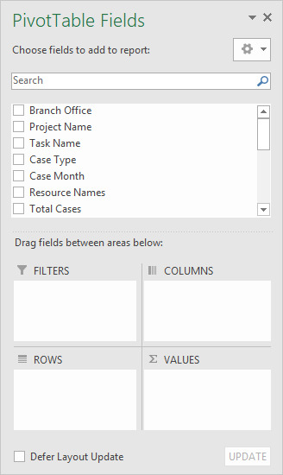
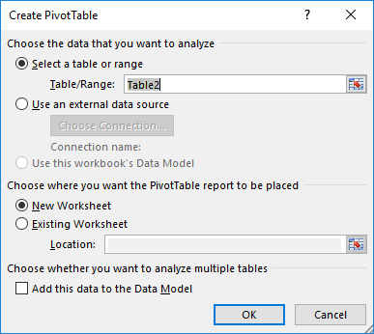
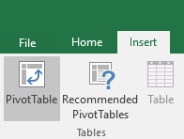
Excel PivotTables
DATA SOURCE
PivotTable 1
PivotTable 2
PivotTable 3
PivotTable 4

Slide 43
PivotTable Fields
FILTERS
Isolates data (i.e. a report on just 2018 projects, all projects performed for one branch)
COLUMNS
Groups together (consolidates to one row) all the same items from the data column placed here
ROWS
Groups together (consolidates to one row) all the same items from the data column placed here
VALUES
Automatically COUNTs text fields and SUMs number fields by whatever is placed in ROWS and COLUMNS

Slide 44
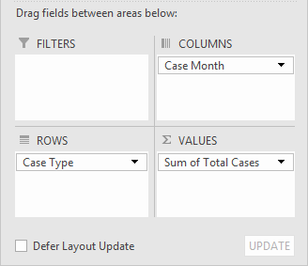
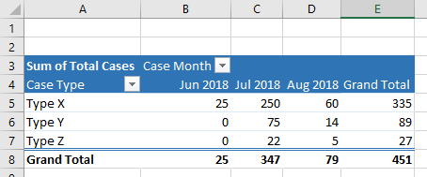
Case Type by Month

Slide 45
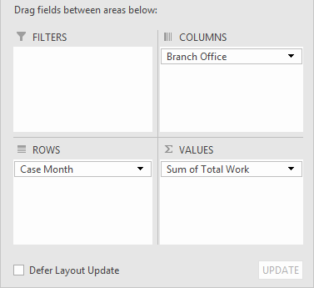
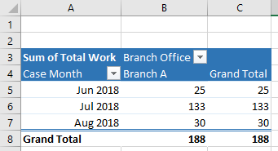
Case Type by Month

Slide 46
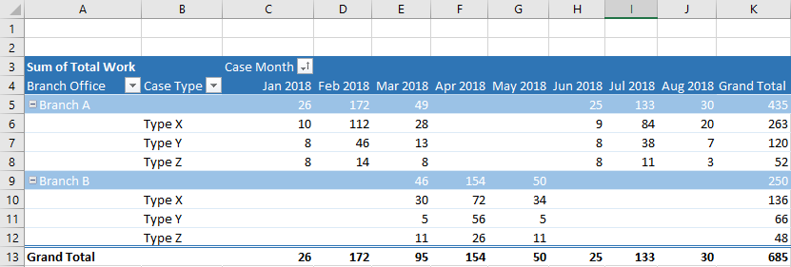
Additional Example Data

Slide 47
Conclusion
Concentrated only on tasks
Prorated timescale of data possible, but not “simple”
Exporting Usage Views (Assignment Data) is far more complex
Shaped perfectly for this example
Task naming conventions
Calculations of items or units produced
Excludes other technologies
Access to technologies may alter the process

Slide 48
Questions?

Slide 49
Thank You!
Data Analysis using Project with Excel
November 28, 2018x @ 12pm-1pm EST jbongiovani@edwps.com
Notes:
Start Recording
We are going to go ahead and get started with todays session on xxxxx.

