Slide 1
OnePager Timelines and Gantt Charts from Microsoft Project, Project Online, and Project Server

Slide 2


OnePager Turns Complex Schedules into Beautiful Charts
Microsoft Project
Project Online
Project Server
Project for the web (2023)

Slide 3
About OnePager
Founded in 2005
Offices in Denver and Auckland
Widespread Adoption
  19 of the 20 largest pharmaceutical companies globally
  9 of the 10 largest aerospace and defense contractors in the USA and Europe
  More than 90 government agencies
  More than 50 countries

Slide 4
Why OnePager?
Save time
Improve visibility
Streamline communications
Standardize reporting
Avoid errors and omissions

Slide 5
Live Demonstration

Slide 6
OnePager Examples

Slide 7
Gantt Chart with Swimlanes and Key Milestones

Slide 8
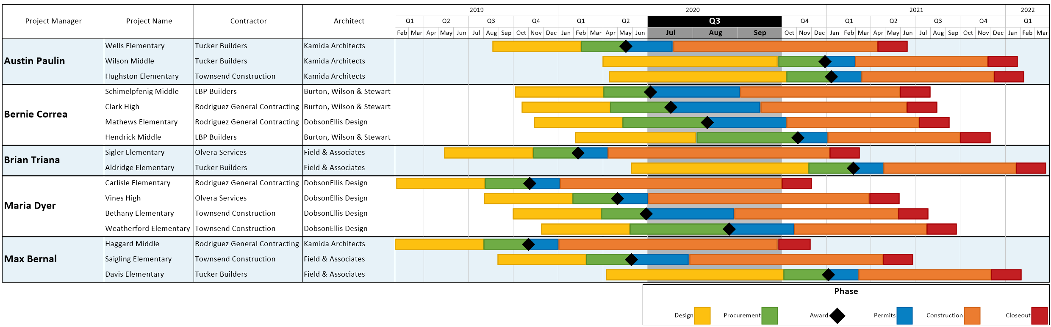
Portfolio Phase & Resource Tracking

Slide 9
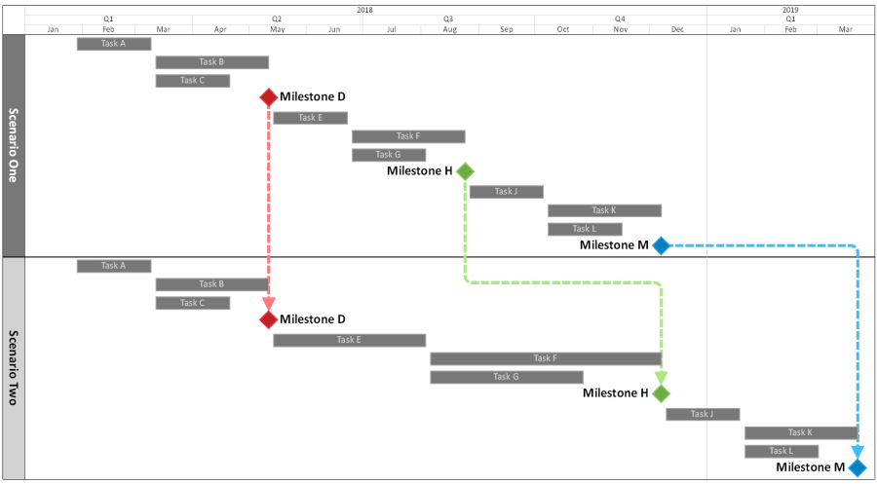
Multiple Scenario Comparison

Slide 10
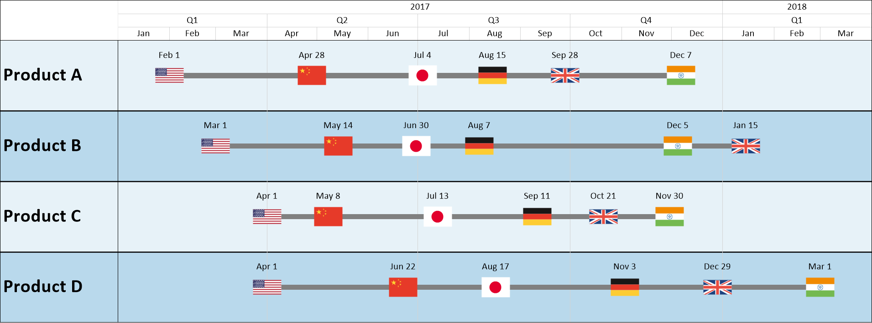
International Product Launch Timeline

Slide 11
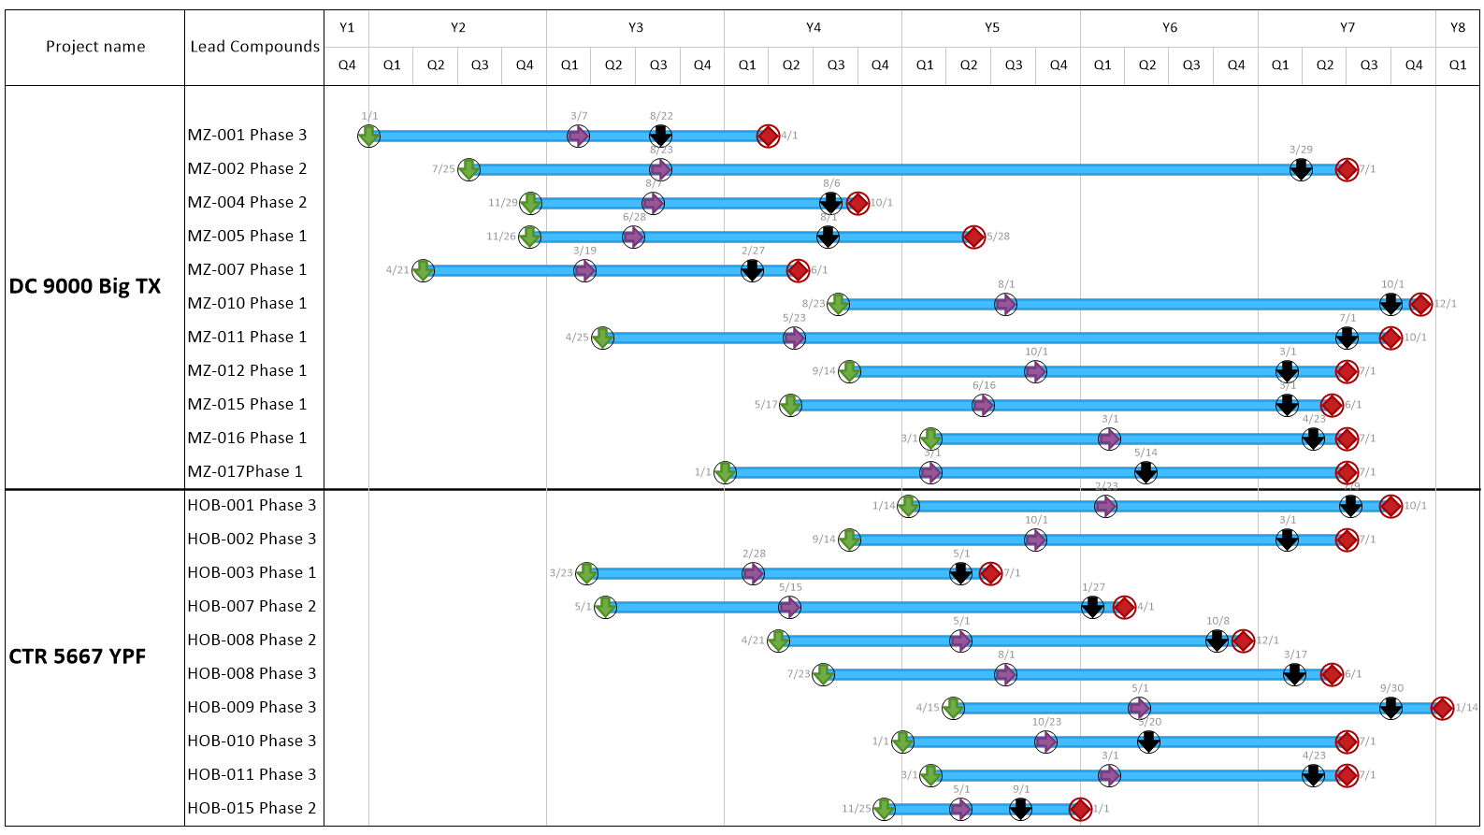
Birds on a Wire Timeline (Multi-Project)

Slide 12
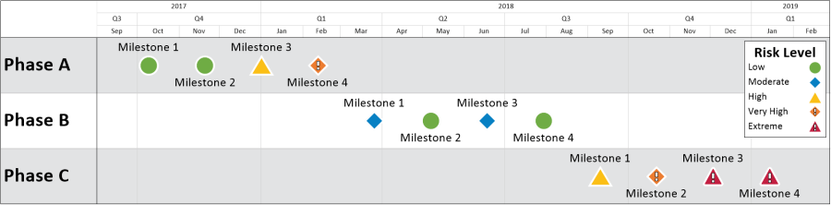
Single Project Milestone Risk Report

Slide 13
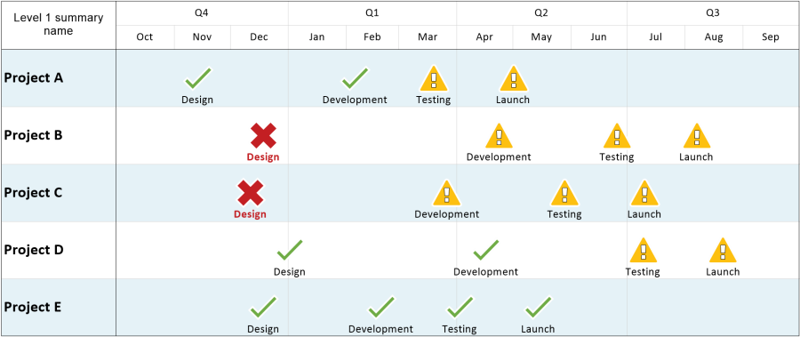
Multi-Project Milestone Risk Report

Slide 14
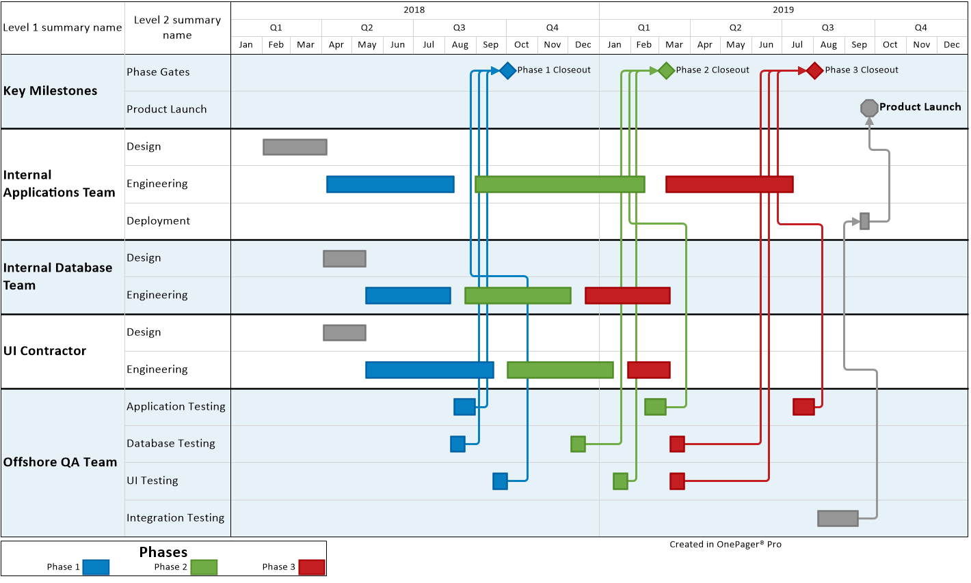
Project Dependency Tracker

Slide 15
Features and Editions

Slide 16
Key Features
* Indicates patented feature
Import from Microsoft Project, Project Online, Project Server, or Project for the Web (coming 2023)
Portfolio: Build charts from multiple projects at once, or one at a time.
Layout: Automatically position tasks/milestones
  Gantt chart: One task per row (waterfall)
  Timeline: Multiple tasks aligned left-to-right
Swimlanes*: Group and sort by any field
Formatting*: Conditional formatting assigns colors, shapes, and more
Snapshots*: Build one chart and track changes over time
Templates: Standardize the look and feel across the team

Slide 17
OnePager Licenses
Multiple Editions
  OnePager Bundle: Microsoft Project, Project Server, Project Online, Smartsheet, Primavera P6, or Excel
  OnePager Pro: Microsoft Project, Project Server, or Project Online
  OnePager Express: Excel, and any other Excel-friendly PM tools
Perpetual License: One-time fee for a lifetime license
Volume & Enterprise Licensing: Available for medium or large teams
Upgrades & Support: Annual fee for unlimited upgrades and support
Training: Available for teams on-site or online.

Slide 18
Next Steps & Contact Information
Safford Black
www.onepager.com
Free Trial (30 days instead of 15 for MPUG members by using this link)
sales@onepager.com
+1.303.779.0344

