Slide 1
Mike Thomas
Excel - Power Query for the
Everyday Excel User - Part 1

Slide 2
Importing Data
Database
Website
Text File
SharePoint List
Azure
Active Directory
Microsoft Exchange
And More!
Excel
Power Query

Slide 3
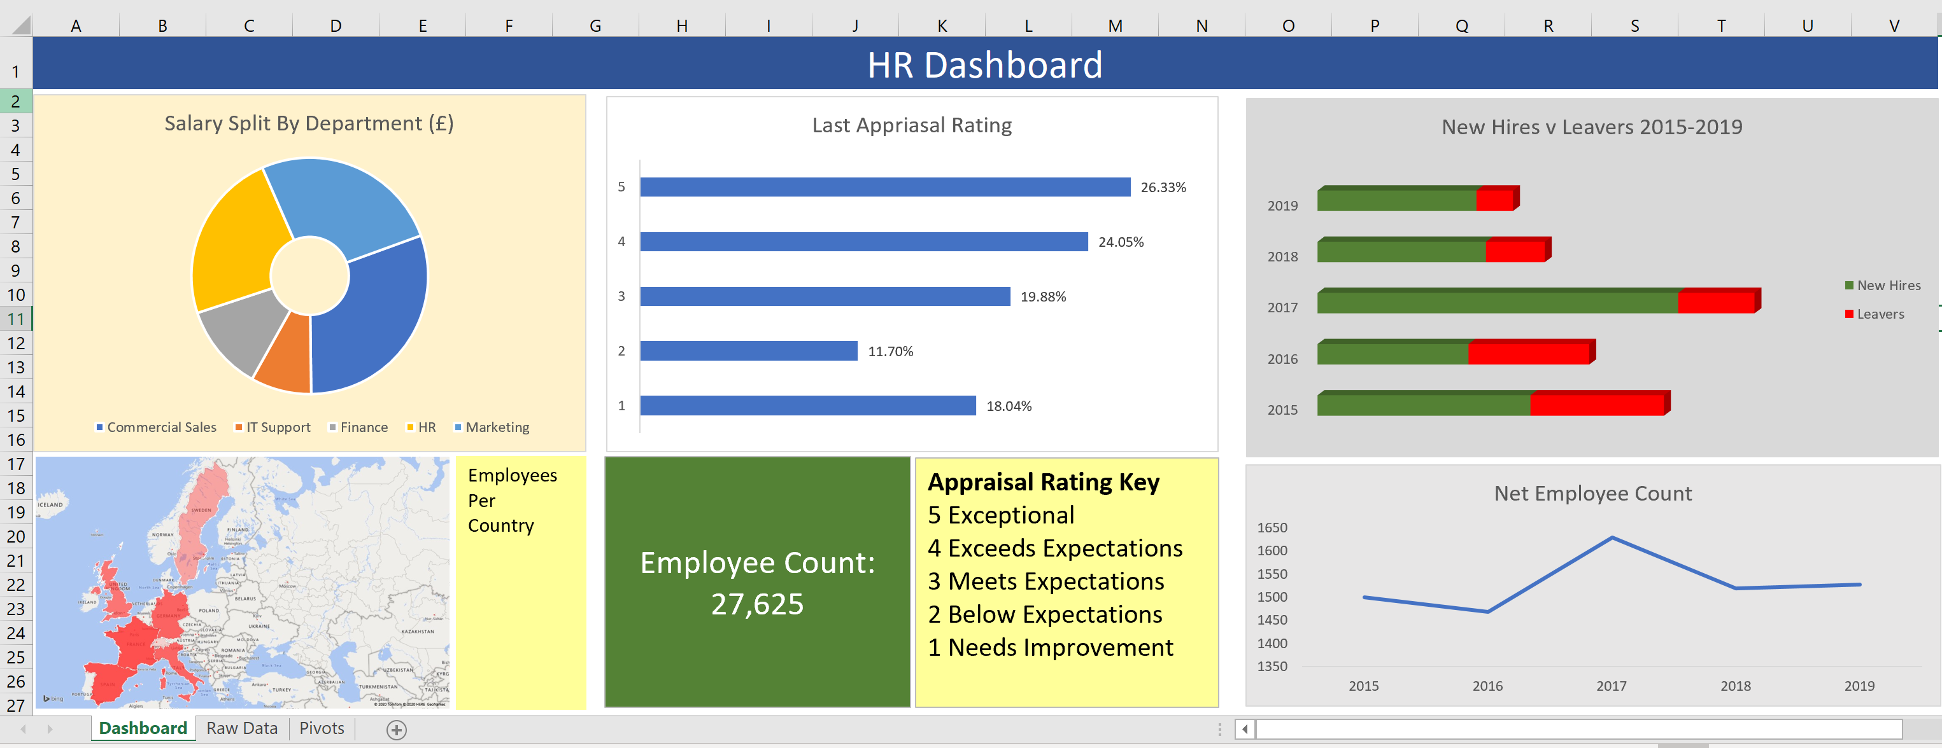
Importing Data

Slide 4
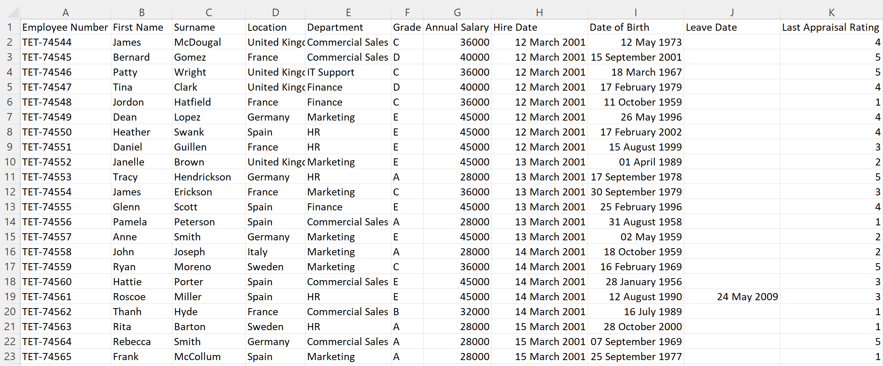
Importing Data

Slide 5
Importing Data
HR System
File Edit New Admin Window
New
Save
Export…
Employees.csv

Slide 6
Importing Data
Employees.csv
Employees.xlsx

Slide 7
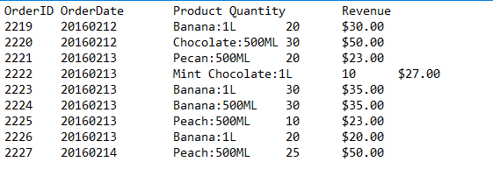
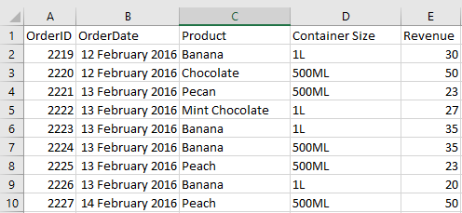
Clean Up Imported Data
From this….
To this….

Slide 8
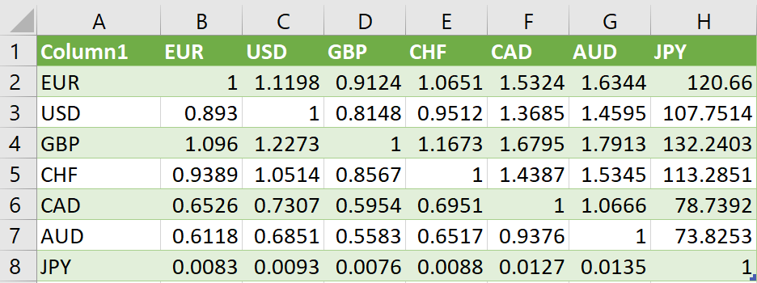
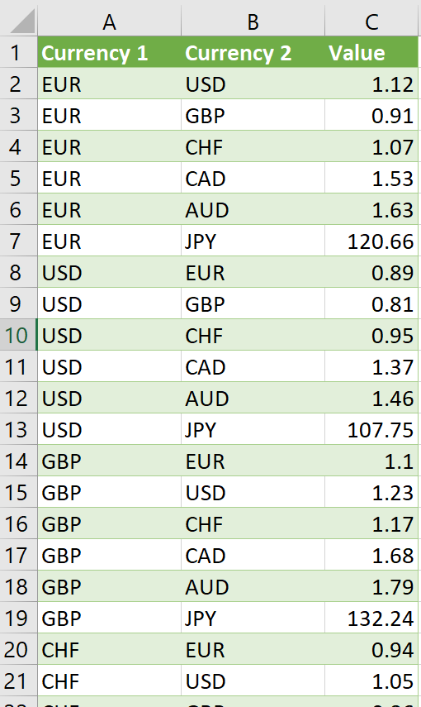
Transform Data
From this….
To this….

Slide 9
Transform Data
AMERICA.xlsx
100 records
Global Sales.xlsx
420 records
EMEA.xlsx
120 records
ASIAPAC.xlsx
200 records

Slide 10
Power Query (Excel 2010 & 2013 for Windows)

Slide 11
Excel 2016 and later
Power Query is not required. Importing, cleaning and transforming data is done via built-in commands in the Get and Transform section of the Data Ribbon

Slide 12
Mike Thomas
Email: mike@mthomas.co.uk
The Excel Trainer: http://theexceltrainer.co.uk

