Slide 1
Man Hours and Cost Tracking Using Microsoft Project
PDU Code: mpugXXXXXX
Date: 09 27, 2023
Time: 12:00 pm - 1:00 pm
Presenter Info: Mike Agnello
Mike Agnello is a Project Management consultant with Edwards Performance Solutions specializing in custom solution development around Microsoft Project and Microsoft Project Server. Mike began his career in 1989 developing test program solutions for military fire control systems, he quickly became an engineering lead transitioning his programming and troubleshooting skills from electronics to project management. Drawing from an extensive background working with defense contractors with emphasis on Earned Value management, Mike has developed practical solutions using Microsoft Project to track Earned Value Management metrics. Mike has worked with several clients in the Maryland and DC area tailoring project desktop and project server to meet their needs while providing practical advice on a variety of Project Management topics. Mike can be contacted by phone at 443-561-1311 or via e-mail at magnello@edwps.com.
Notes:
Satya Narayan Dash is a management professional, coach, and author of multiple books. Under his guidance, over 2,000 professionals have successfully cracked PMP, ACP, RMP, and CAPM examinations – in fact, there are over 100 documented success stories written by these professionals. His course, PMP Live Lessons – Guaranteed Pass, has made many successful PMPs, and he’s recently launched RMP Live Lessons – Guaranteed Pass and ACP Live Lessons – Guaranteed Pass. His web presence is at https://managementyogi.com, and he can be contacted via email at managementyogi@gmail.com.

Slide 2
Man Hours and Cost Tracking Using Microsoft Project
GoToWebinar Tips
Type Questions into the “Questions/Chat” window
Collapse/expand the control panel with the orange arrow
Use the ZOOM tool on the Viewer as needed
Use the camera icon on your Viewer to take screenshots that are saved to your desktop
Notes:
Satya Narayan Dash is a management professional, coach, and author of multiple books. Under his guidance, over 2,000 professionals have successfully cracked PMP, ACP, RMP, and CAPM examinations – in fact, there are over 100 documented success stories written by these professionals. His course, PMP Live Lessons – Guaranteed Pass, has made many successful PMPs, and he’s recently launched RMP Live Lessons – Guaranteed Pass and ACP Live Lessons – Guaranteed Pass. His web presence is at https://managementyogi.com, and he can be contacted via email at managementyogi@gmail.com.

Slide 3
Objectives
Explore the options and elements utilized for man hour and cost planning and tracking.
Explore the schedule elements that contribute to man hour and cost planning and tracking.
Overview the tracking techniques for task resource assignments that contribute to man hour and cost planning and tracking,
Explore the views and reports available for man hour and cost planning and tracking.

Slide 4
Demo in Microsoft Project

Slide 5
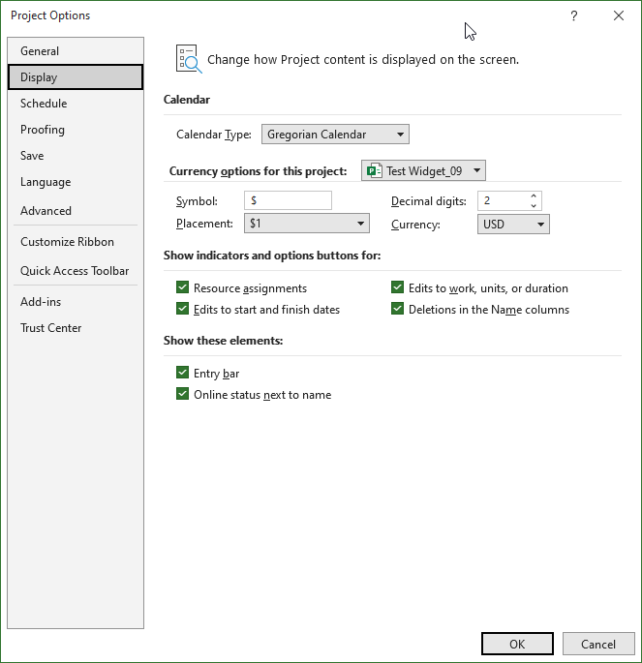
Project Options: Display
Cost Tracking
Currency Options
Variety of currency types
Currency Options
Notes:
Using the drop-down menu in Calendar Type, you may choose from Gregorian, Hijri, and Thai Buddhist calendars. Gregorian, however, is the calendar most commonly used.
The type of currency to be used in the project can be set in the Currency drop-down menu. There are 156 types of currency to choose from, including the U.S Dollar, Yen, and Euro. For the purposes of this course, make sure that the currency is set to USD.
The next several pages will explore the other Project Options menus. In the top portion of each page, a light gray box will highlight the area of the menu window that contains the options being discussed.
2
5

Slide 6
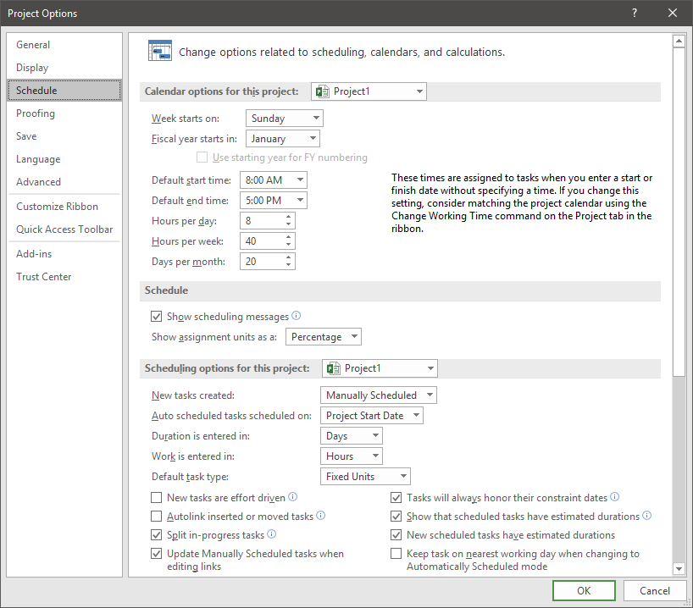
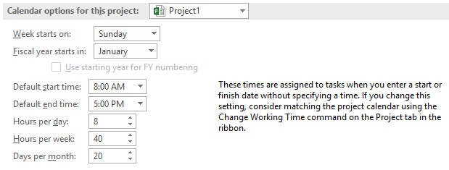
Project Options: Schedule
Man Hours Tracking
Default work hours for the day
Default work hours for the week
Default work days in a month
Hours per day, week and month.
Notes:
The U.S. Federal Government’s fiscal year begins October 1 and runs through September 30 of the following year. For example, fiscal year 2019 started October 1, 2018 and ended September 30, 2019. Many private companies follow the calendar year, beginning on January 1 of a year and running through December 31 of the same year. For budgeting and financial reporting reasons, it is important to know which type of fiscal year your project is using.
Work hours and times for the days, weeks, and months can be changed here, as well. These options can be changed for a specific project or for all projects, using the drop-down menu under Calendar options for this project. Working times may be changed because employees have different work times on different days, depending on the type of industry or project on which you are working.
2
6

Slide 7
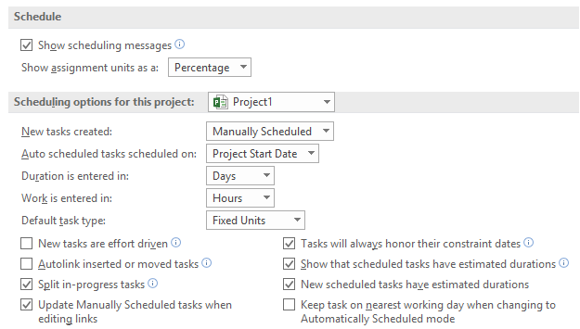
Project Options: Schedule
Man Hours Tracking
Show Assignment Units
Work Entered in
Default Task Type
Effort Driven
Assignment Units
Work entered in
Task Types
Tasks are effort driven
Notes:
Auto-scheduled tasks are scheduled from the project start date or the current date, but starting on the project start date is recommended.
Resource assignments can be shown as a decimal (.50) or as a percentage (50%) by selecting an option in the units drop-down menu.
Other scheduling options can be set for all projects or for the current project only. Duration and work can be entered in days and hours and the default task type can be set.
2
7

Slide 8
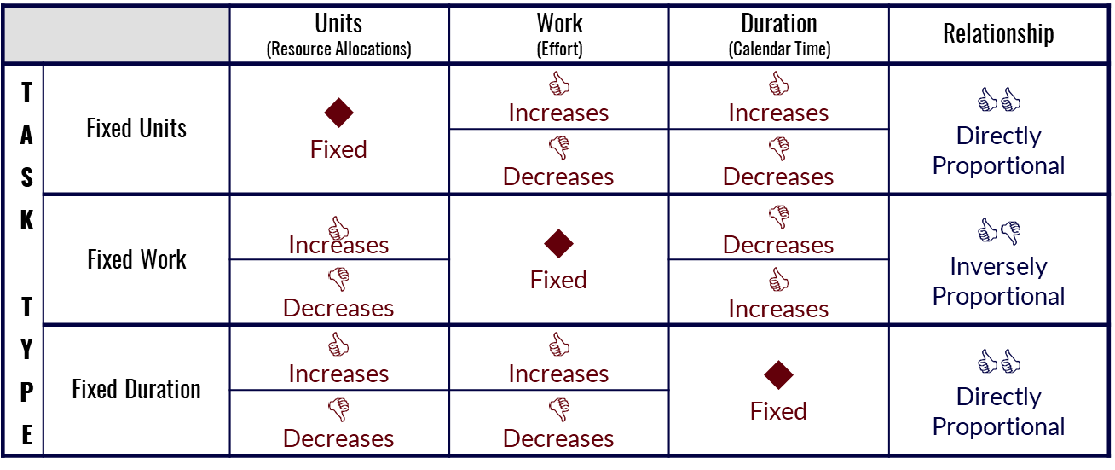
Project Options: Schedule – Task type
Basic algebraic relationship in Project is
(Units) x (Duration) = (Work)
In this simple algebraic equation
Fixing one variable and changing the other will cause recalculation of the third
The following chart shows the relationships between each variable in the equation
What happens when you change one of the Fixed variables?
Notes:
In Project, Units represent the amount (as a percentage) of a resource’s (person’s) time that is dedicated to a particular task. Work is the number of actual working hours needed to complete the particular task. Duration is a measurement of time, on a calendar, that will be needed to complete a task. Be careful not to confuse Work and Duration. It may take 12 hours of work to complete a task, but if you are working on it 4 hours per day only, the task will have a duration of 3 days (3 days x 4 hours/day = 12 hours).
The Default Task Type option, pictured on the previous page, allows you to set one of these variables as fixed. In the previous paragraph, the resource can be fixed at working 4 hours per day (or 50% of an 8-hour work day) only, the task can be fixed at 12 hours of work, or the duration can be fixed at 3 days. Changes in one factor will affect the other, unfixed factor. How the other factor is affected is pictured above. For example, if a person’s dedication to a task is fixed (Fixed Units), any increase in work will increase the duration (i.e., if 12 hours of work is increased to 24 hours of work, with only 4 hours per day of dedication [Units = 50%], it will take 6 days to complete). If work is decreased, the duration is decreased also. If the Work is fixed (Fixed Work), an increase in dedication, or units, will decrease the duration (i.e., 12 hours of work being performed for 8 hours per day will be completed in 1.5 days). If the units, or dedication, is decreased, the duration will increase. If the Duration is fixed (Fixed Duration), increases in units or dedication will result in more work being expended on a task (i.e., if a person’s dedication is changed from 4 hours per day [50%] to 8 hours per day [100%], that person’s work hours will increase from 12 to 24 during a 3-day period). The duration remains the same, but the hours spent on the task during that time increase or decrease, depending upon the percent of the resource’s dedication.
2
8

Slide 9
Project Options: Schedule – Task type
Changing the fixed variable in the formula
(Units) x (Duration) = (Work)
If the fixed variable is changed, Project uses an algorithm for updates
Project prioritizes each variable in the formula
The priority determines the order in which variables will be changed
Duration has the lowest priority – it changes first
Work has a medium priority – it changes second
Units has the highest priority – it changes last
Applying the priority algorithm to the formula determines how the variables will react to changes
Notes:
Sometimes, it is necessary to change the fixed variable in a task (either Units, Work, or Duration). When that fixed variable is changed, Project will recalculate the schedule automatically. However, its recalculations are based upon a predetermined prioritization of the three variables. In essence, as listed above, Project will want to change Duration before it changes Work or Units. The last thing that Project will want to change is Units or dedication. In a real working environment, this makes sense. If a task requires more hours (Work), you will want an extra day of work (Duration), as opposed to working a longer day (Units).
Please review the chart in the top portion of the next page and follow along with the examples in the bottom portion. Remember, all of these calculations are allowing you to look behind the scenes of how Project calculates tasks and changes to these tasks. You will not have to do these calculations yourself; the tool will do that for you. Next, prioritization of variables affecting a schedule is explored.
2
9

Slide 10
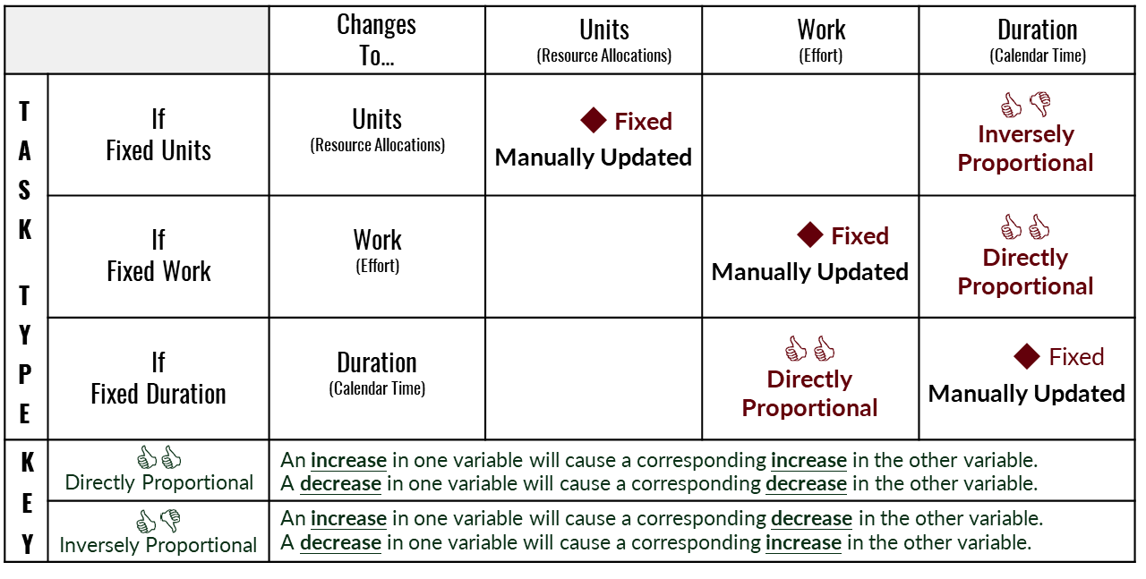
Project Options: Schedule – Task type
This table shows the default recalculations
(Units) x (Duration) = (Work)
Notes:
For example, assume that a resource, Randy Cobbs, is assigned to Task 1 for 40 hours and is working full time (Units = 100%), or 8 hours a day, and the task default is set to Fixed Units. If Randy’s dedication was changed from 100% to 50% manually, Project will start with the lowest priority variable – Duration. In this case, Randy would only spend 4 hours per day working on Task 1 and would, therefore, take 10 days (4 hours/day x 10 days = 40 hours) to complete the task. However, in the case where Units is a fixed variable, a manual change in the Work or the Duration will affect the other variable (Duration or Work). If work were increased from 40 to 80 hours (with Units as the fixed variable), Project would change the Duration of the task (again, from 5 to 10 days), while leaving Units alone. If the Duration is changed, the Work will change correspondingly. Units will not change.
In the other variations listed above, keep in mind that Project will change the Units as a last resort. If Work is fixed, Project will change Units only if the Duration is altered manually (i.e., if 40 hours of work is scheduled over 10 days at 50% dedication 4 hours/day and you change the Duration to 5 days, Project will increase Units to 100%, so 40 hours of work can be done in 5 days – 8 hours/day x 5 days = 40 hours). If Duration is fixed, Project will change Units only if Work is altered manually (i.e., if 20 hours of work is scheduled over 5 days with 50% dedication and you change Work to 40 hours, Project will increase Units to 100% so that 40 hours of work can be done in 5 days). In any other scenario, Project will automatically lengthen or shorten Duration, depending on manual updates to either Units or Work. If Project cannot alter the Duration (if it is fixed or if it has been manually updated), it will automatically adjust the Work to correspond with Duration and Units.
2
10

Slide 11
Project Options: Schedule – Effort Driven Option
Effort driven option affects the basic calculations only after an initial resource assignment is made to the task
When a task is marked as effort driven, the total task work is held constant
Regardless of the number of resources assigned to the task
When additional resources are assigned to an existing task
Remaining work is distributed evenly among assigned resources – individual resource work assignments decrease
Task Duration or Resource Units are adjusted also, depending on the Task Type
When resources are removed from an existing task
Remaining work is redistributed to remaining resources – individual resource work assignments increase
Task Duration or Resource Units are adjusted also, depending on the Task Type
Notes:
Another default option in the Schedule Options window is New Tasks are Effort Driven. This option, as outlined above, affects Project calculations only after a resource (or resources) have been assigned to the task. The task’s work will remain the same, but the distribution of work between the resources that are added or removed from the task will change with each alteration.
For example, let’s assume Task 1 will require 40 hours of work, has Fixed Units (or dedication) and Randy Cobbs has been assigned to the task full-time (Units = 100%). Project has calculated the Duration to be 5 days (8 hours/day x 5 days = 40 hours). If Randy has worked 8 hours on the task already and has 32 hours remaining when we add another resource (Sharon Ebbs), Project looks to see if the task is Effort Driven. If it is turned ON, Project will not change the Units (or dedication) of each resource. Instead, the Remaining Work of 32 hours will be divided evenly between Randy and Sharon (16 hours each) and the duration of 5 days will be reduced to 3 days, since Randy’s 16 hours and Sharon’s 16 hours can be completed at the same time. Effort Driven being turned ON emulates the real world better. In most cases, the reason that a Project Manager adds a resource to a task is to decrease the duration of the task.
Please take a moment to examine the chart in the top portion of the next page and the examples in the bottom portion.
2
11

Slide 12
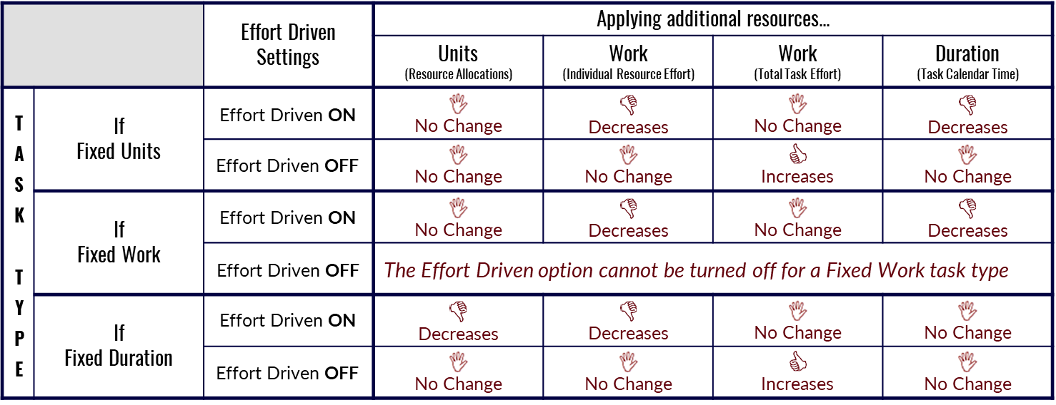
Project Options: Schedule – Effort Driven Option
How does the Effort Driven option affect the selected task type?
If resources are removed from the task, the reverse effect happens
Notes:
As explained in the example on the previous page, adding resources to an Effort Driven task with Fixed Units will cause Work for the individual resource to decrease. In addition, the duration will be shortened. However, the overall amount of work will remain the same. The same is true for Effort Driven tasks for which the Work is fixed. Additional resources will complete the same amount of work in less time with a smaller workload assigned to each individual. A circumstance in which the Duration would not be affected is if Duration is the fixed variable. In this situation, adding resources would cause resources to spend less time on a task and reduce their individual workloads. For example, let’s assume a task has a fixed duration of 5 days and will require 40 hours of work. Randy Cobbs is assigned to the task at 100% dedication (8 hours per day). Then, an additional resource, Sharon Ebbs, is assigned. Because the duration (5 days) cannot change and the overall Work of the task (40 hours) cannot change, both Randy and Sharon will be allocated to that task at 50% dedication only. Each one will complete 20 hours of work during that same 5-day period.
As mentioned previously, these calculations are completed automatically by Project. The purpose of these explanations is to provide an insight into how the tool operates, so that you can customize your project to your specific needs better. We will continue exploring the various Project options now.
2
12

Slide 13
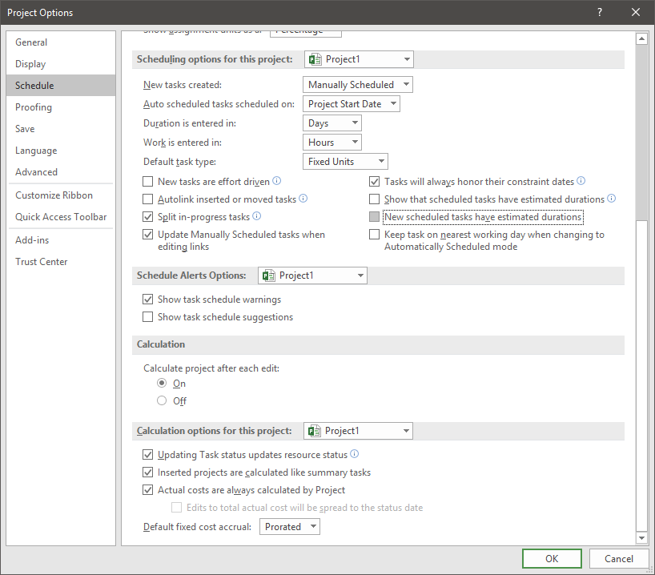
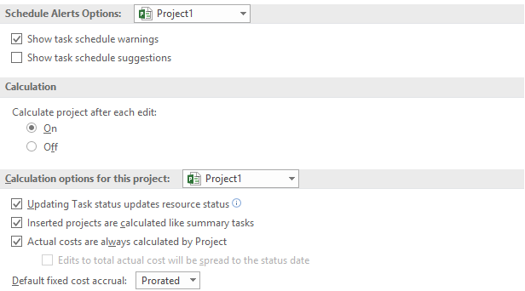
Project Options: Schedule
Cost Tracking – Calculation Options
Default Fixed Costs Accrual
Prorated, Start, or End
Actual Cost Calculation
Project Calculated or Manual Entry
Actual cost calculation
Fixed cost accrual
Notes:
Alerts can be turned on or off for all projects or for the current project only. As shown in the menu above, Show task schedule warnings is enabled and Show task schedule suggestions is disabled.
There are calculation options that can be set for a project, as well. Calculations for the project can be made after each edit or they can be disabled. All options in the menu above are turned on: Updating task status updates resource status, Inserted projects are calculated like summary tasks, and Actual costs are always calculated by Project.
Fixed cost accrual can be set as prorated, start, or end.
2
13

Slide 14
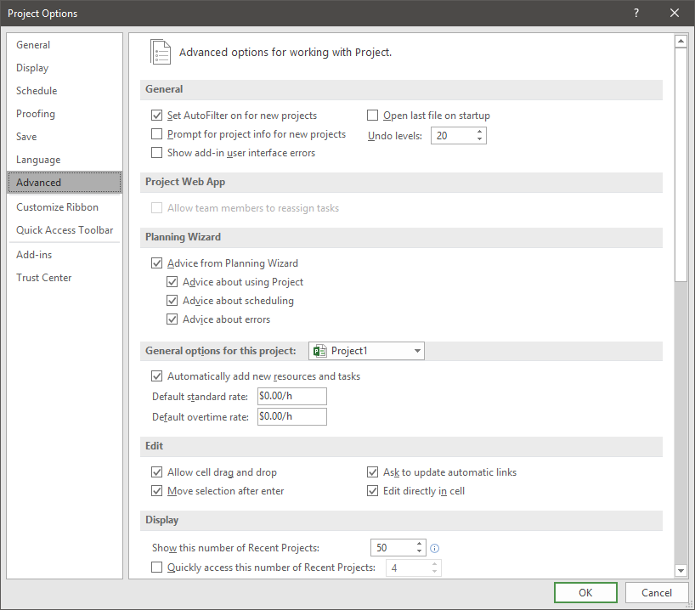
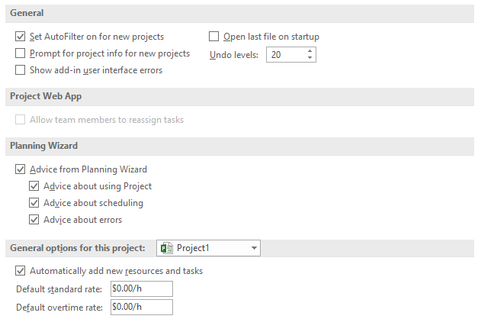
Project Options: Advanced
Cost Tracking
Default Rates
Standard and Overtime
Default resource rates for standard and overtime
Notes:
The menu shown above displays new, advanced options for Project. A project can have up to 99 Undo levels. The default is 20.
Options for the Project Planning Wizard can be set here. The Planning Wizard will offer tips and hints for the project, such as advice about using Project, scheduling, and errors. These options can be enabled or disabled.
General options can be set for all projects or for the current project. To add new resources and tasks automatically, turn on or check the box in the menu above. The defaults for standard and overtime rates are measured in dollars per hour.
2
14

Slide 15
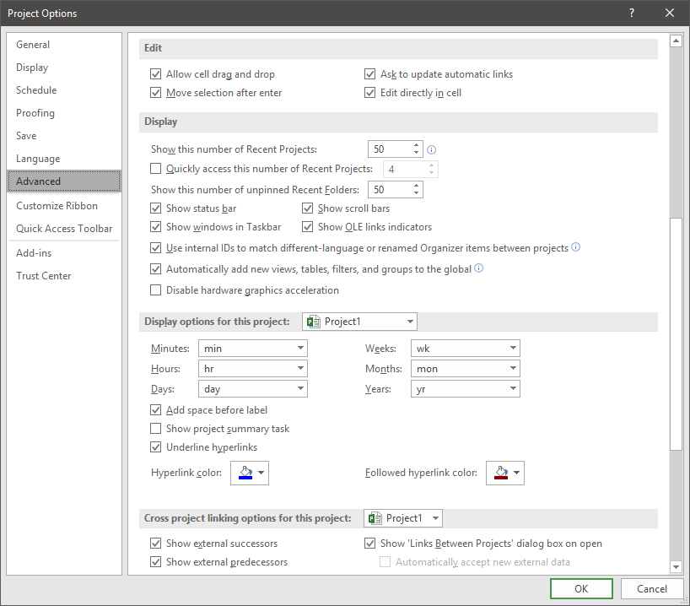
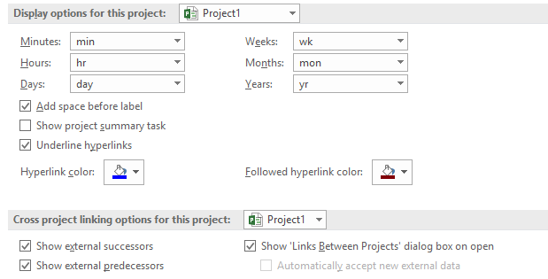
Project Options: Advanced
Man Hours Tracking
Units Display Options
Unit Display Options
Notes:
Display options for units of time-measurement can be set from this menu, as shown above. The words for minutes, hours, days, weeks, months, and years can be abbreviated or spelled-out.
Hyperlink options can be set from this menu, also. The hyperlink and the followed hyperlink can be set to any color .
Options for cross-project linking can be set to Show external successors, Show external predecessors, and Show ‘Links Between Projects’ dialog box on open. These options should be turned ON.
2
15

Slide 16
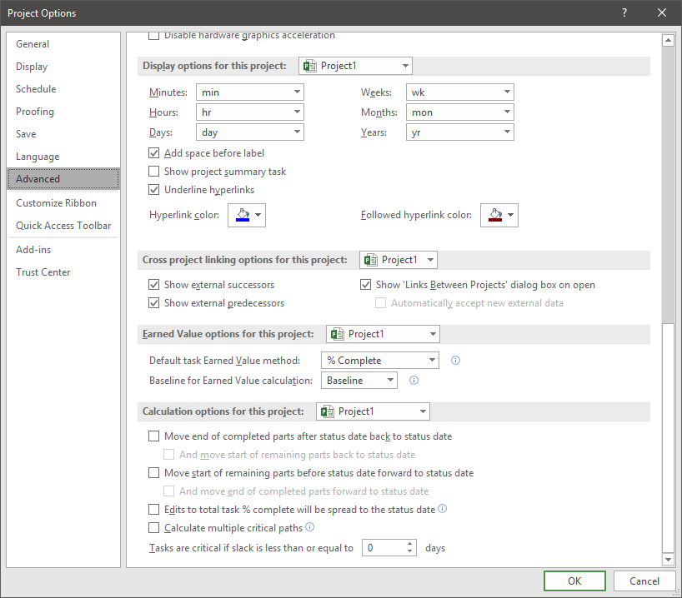
Project Options: Advanced
Cost Tracking
Earned Value Calculation
Select calculations based on percent complete (actual duration/total duration) or physical percent complete
Select baseline to be used in calculation
The Earned Value can be calculated based on either % Complete (based on task duration) or Physical % Complete
Physical % Complete is a task-level field. If used for earned value calculations, each value must be entered manually for the task
Notes:
An earned value management system integrates the project work scope with the schedule and cost elements of the project, in order to plan, measure, and manage project progress and risks, as well as to optimize status and control.
Edwards Recommendation: The default for this setting is % Complete, however, Edwards recommends using Physical % Complete, since its behavior is consistent with the earned value best practices and standards.
2
16

Slide 17
Project Options: Advanced
Man Hours Tracking
Calculation options
Defines project-specific calculations
Calculation options work together with the Schedule project calculation options
Allows for calculation of single or multiple critical paths
Defines the amount of slack required for a task to be assigned as critical
Calculation sub-options work in tandem with Updating to Task Status updates resource status option on the schedule group
Notes:
2
17

Slide 18
Status Calculation Options Description
Move start of remaining parts before status date forward to status date option
Status Date Line
No Completion of work
Behind schedule
Uncompleted portion
rescheduled beyond status date
Partial Completion
Behind schedule
Uncompleted portion
rescheduled beyond status date
Move end of completed parts after status date back to status date option
Partial Completion
Ahead of schedule
Completed portion ending at status date
And move start of remaining part back to status date
Uncompleted portion will now start just beyond the status date
Notes:
18

Slide 19
Tracking/Planning Elements - Project Resources
Resource Types
Work, Material, Cost
Resource Rates
Standard, Overtime, Cost/Use, Accrual
Max Units
Resource Rates and Options
Resource Types
Max Units
Notes:
Project resources may have different schedules that affect the project’s timeline. We will enter the variations for John Jones’, Betty Smith’s, and Randy Cobb’s calendars. Please follow along with the instructions in the top portions of the next several pages.
4
19

Slide 20
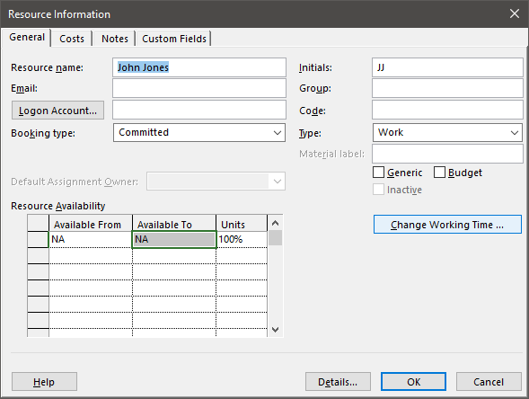
Man Hour Tracking Elements – Availability
Resource Availability
Establish Availability Windows
Resource Availability Windows.
Notes:
This slide is explaining the importance of sequencing activities.

Slide 21
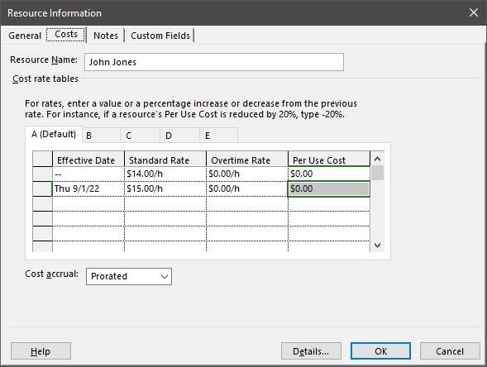
Man Hour Tracking Elements – Rate Tables
Resource Rates
Five Rate Tables
Selectable at assignment
Time periods for rates
Accrual
Resource Availability Windows.
Notes:
This slide is explaining the importance of sequencing activities.

Slide 22
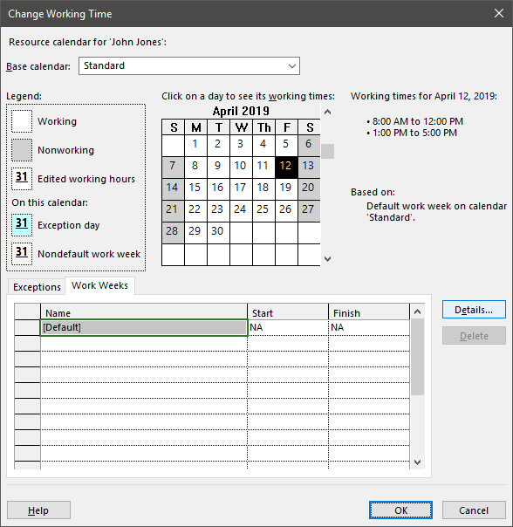
Man Hour Tracking Elements – Change Working Time
Resource Calendar and Workweeks
Specify unique resource workweek settings
Calendar Exceptions
Notes:
4
22

Slide 23
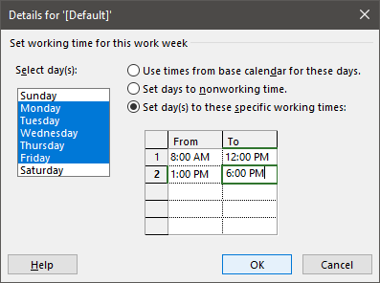
Man Hour Tracking Elements – Workweek Settings
Specific workweek options
Select specific days
Working/non-working times
Set specific work windows
Notes:
When changing the working time, make sure that Set day(s) to these specific working times is selected in the dialog box, as shown above.
These days and times for John Jones will appear on his calendar. Knowing the working times for resources is important because, when they are assigned to a task, you want to know that they will be able to do the work for that task.
Note: When applying resource working hour changes that impact multiple days of
the week, the month that is displayed on the calendar view does not matter.
4
23

Slide 24
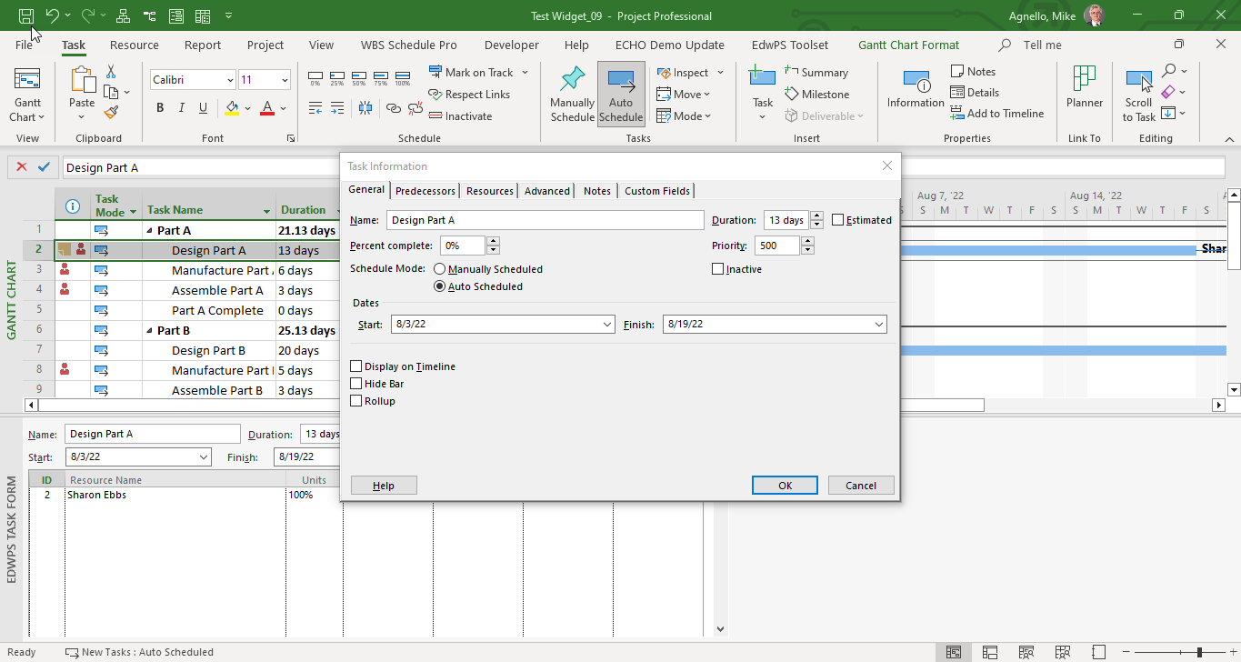
Tracking Elements - Task Details
Task Details Dialog
Notes:
This slide is explaining the importance of sequencing activities.

Slide 25
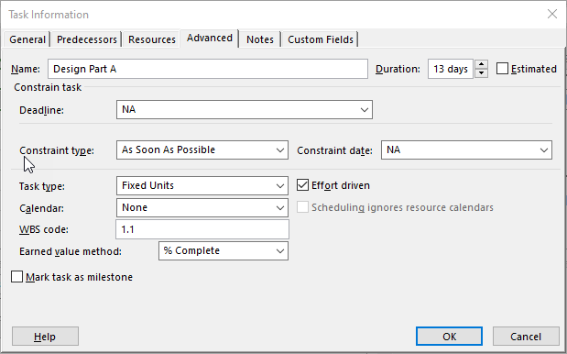
Tacking Elements - Task Details – Advanced Tab
Task Type Selection
Task Calendars
Notes:
This slide is explaining the importance of sequencing activities.

Slide 26
Cost Tracking Elements - Fixed Costs
Fixed costs may be entered on any task in a project
Intended for non-resource based task costs
Predate the Cost resource type
Fixed costs are entered in the task Cost Table
Cost distribution in accordance with accrual method
Actual fixed costs are calculated based on task progress
Cannot be edited
Notes:
26

Slide 27
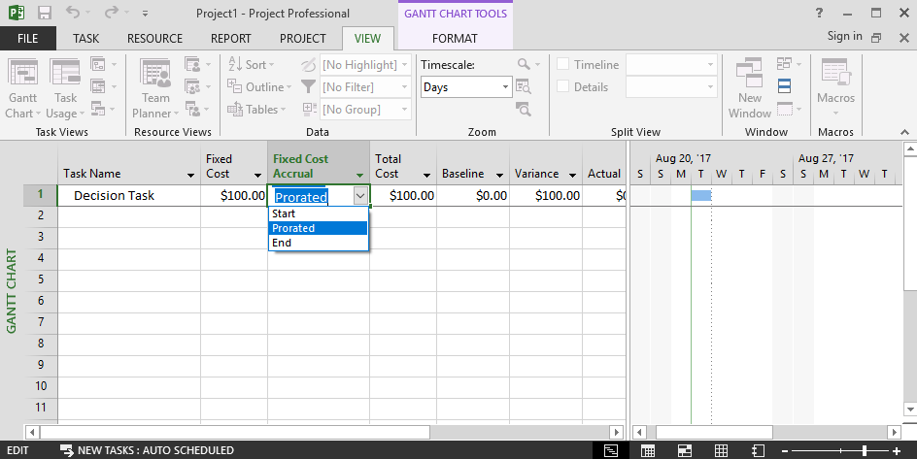
Cost Tracking Elements - Enter Fixed Costs
Fields may need to be added to the task view
Entered within the task tables
Fixed Cost
Fixed Cost Accrual
Notes:
27

Slide 28
Setting the Baseline Plan for Your Project
What is the baseline in Project
The baseline is a copy of the schedule plan
It is a static copy in the database
It is used as a comparison tool against
Schedule status and tracking
Revisions to the original plan
Capturing scope changes and incorrectly estimated efforts
When should the baseline be set
When the project schedule plan is approved
Ideally, before starting the project
When should the baseline be changed
Only when a contractual change to the project is implemented
The baseline schedule represents the contractual commitment between you and your customer

Slide 29
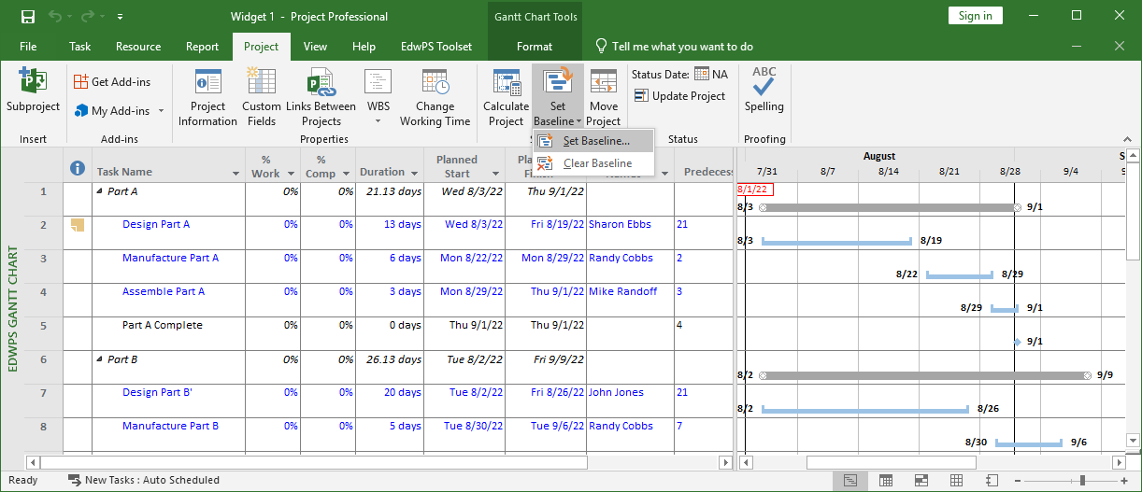
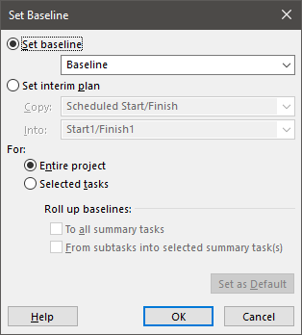
Setting the Baseline Plan for Your Project
To set the baseline
Select the Project tab; select the Set Baseline option from the Schedule group and, then, select Set Baseline
Setting a Baseline to track progress against

Slide 30
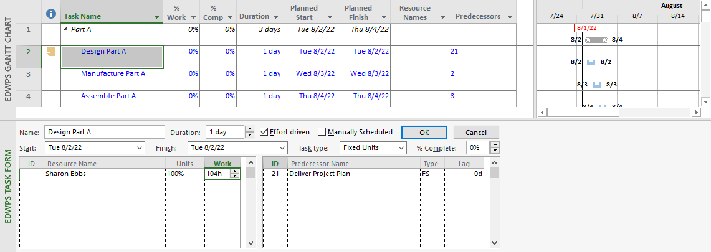
Assigning Resources to Tasks
Once the resource is assigned, the resource Units and Work can be entered
Work and Unit allocation for assignment
Notes:
The units value entered determines how much of Sharon Ebbs’ time is spent on this task. At this time, she is 100% dedicated to this task.
Next to the Units column, enter 104h (or 104 hours) as the amount of work necessary to complete this task.
After this information has been entered, click the OK button and the schedule will update.
Note: Remember, Work is different than Duration.
Work is effort and Duration is time.
5
30

Slide 31
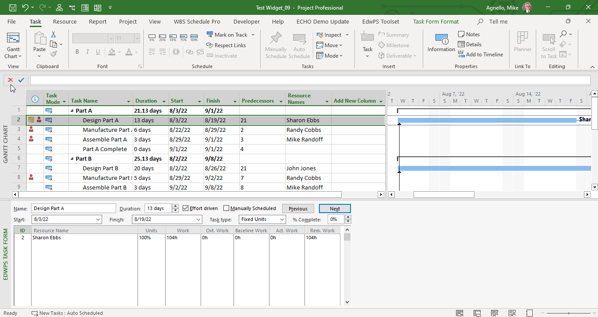
Tracking – Actual/Remaining
Actual and Remaining Work may be entered into form for tracking
Actual and Remaining Work

Slide 32
Cost Tracking - Assigning Cost Resources
Cost resources have cost entered at the assignment level
Select the resource (Vendor Part) from the drop-down menu, under Resource Name on the Task Form. Click OK
Enter the estimated cost for Lodging as $150 in the Cost column. Click OK
When done, hide the EdwPS Task Form
Cost Form
Enter a Cost Resource
Note: Cost Resources do not contribute to Earned Value Calculations
Set the Cost for the Assignment
Notes:
Mike Randoff has $150 of lodging costs that need to be entered for this task. In the Task Form view, under the Cost column, make sure $150 has been added.
Make sure that the information is correct. Then, click OK. To return to the Gantt Chart view, hide the split-screen view.
Note: When adding a Cost resource to a task, you must click OK after the cost resource is selected from the drop-down menu and before the cost value ($150) is entered for the resources.
5
32

Slide 33
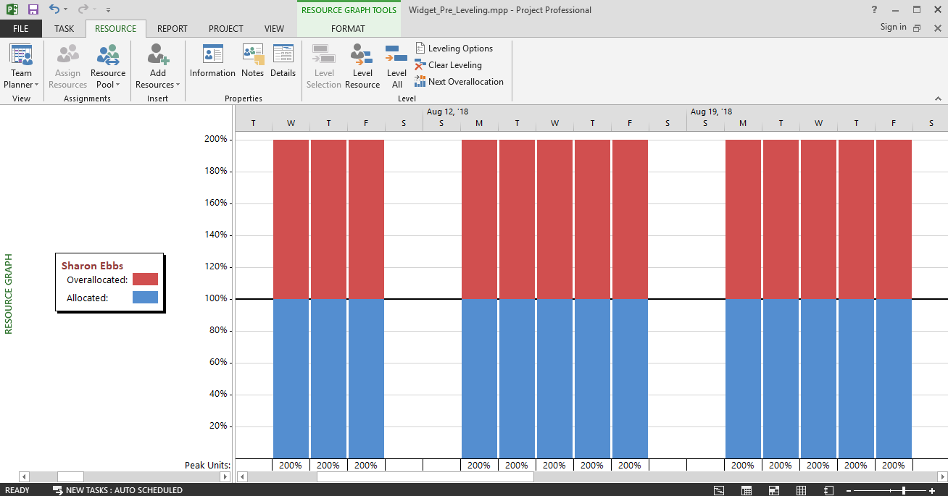
Man Hour Tracking - Resource Graph View
Shows allocations graphically
Timescale can be adjusted from View Tab
Scroll through resources using left hand scroll bar
Use scroll bar to cycle through resources
Notes:
33

Slide 34
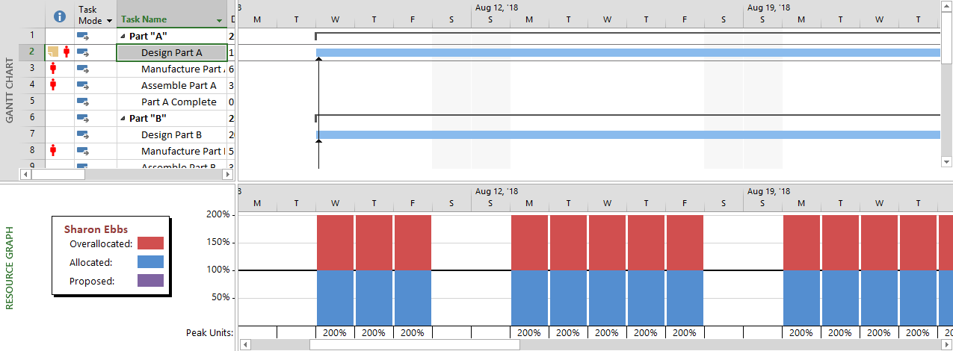
Man Hour Tracking - Split View (Graph on Bottom)
Select tasks on in a Gantt view to review allocation issues
Notes:
34

Slide 35
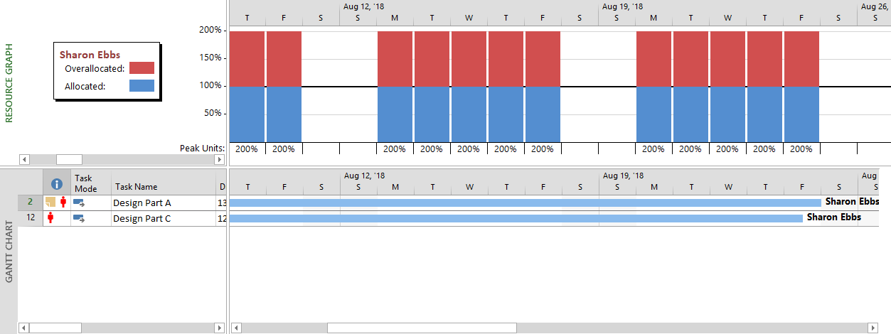
Man Hour Tracking - Split View (Graph on Top)
Scroll through resources and view their task assignments
Notes:
35

Slide 36
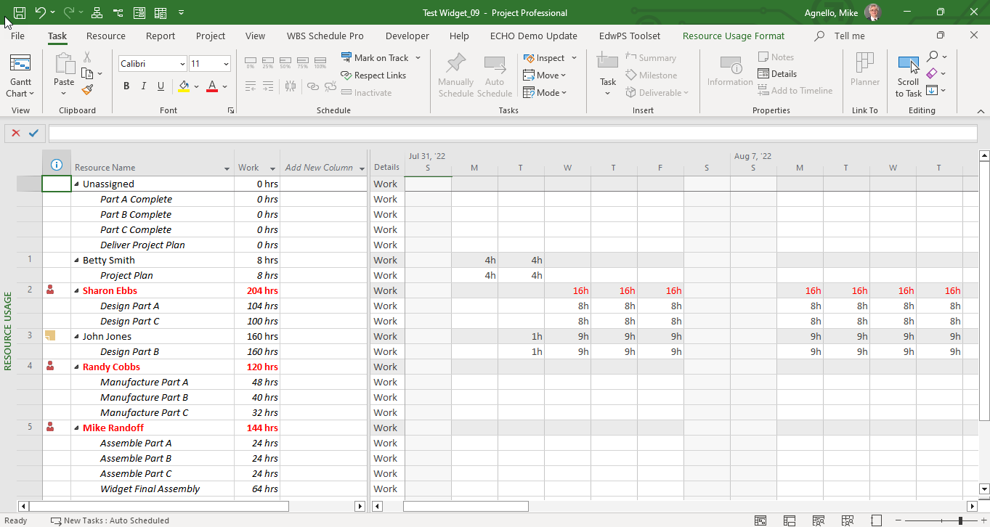
Tracking - Resource Usage View
Resource Usage view shows Assignment by Resource
Overallocations show in Red

Slide 37
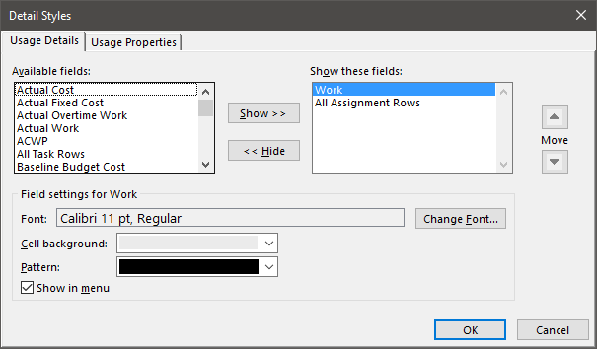
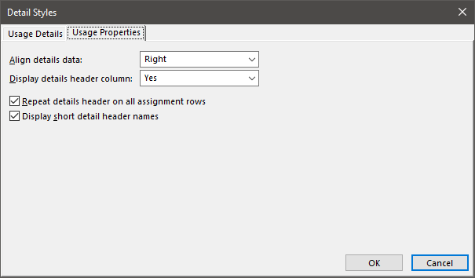
Tracking - Detail Styles Dialog
Add and order rows using the Detail Styles dialog
Notes:
Available fields are selected from the drop-down, then added to the view using the Show>> button. Each row can have a different font, cell color, and pattern. The Show these fields menu option includes the selected field in a list of available fields that are turned on or off without going to the Detail Style dialog. The list of fields is shown by right-clicking on the time-phased grid and selecting fields to include. The Usage Properties tab provides options for specifying how data defines the display of labels and data.
37

Slide 38
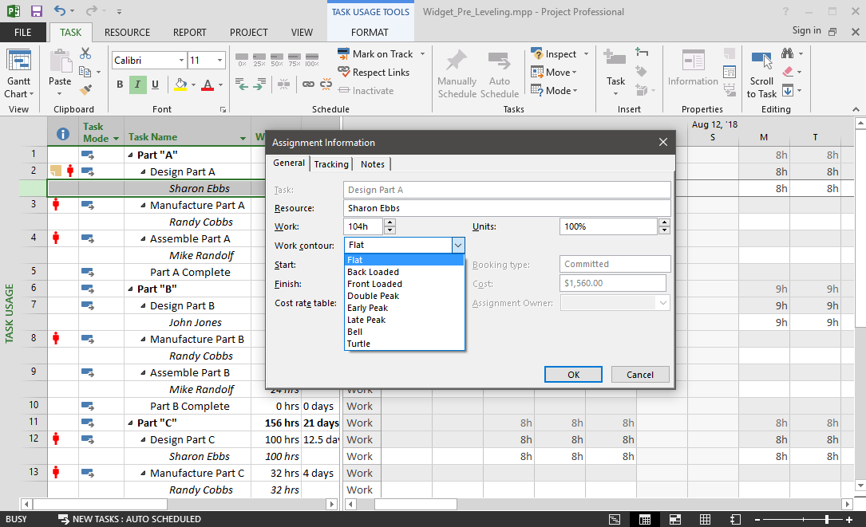
Resource Contouring
Contour can be set for an assignment from any usage view by double-clicking on a resource
Notes:
38

Slide 39
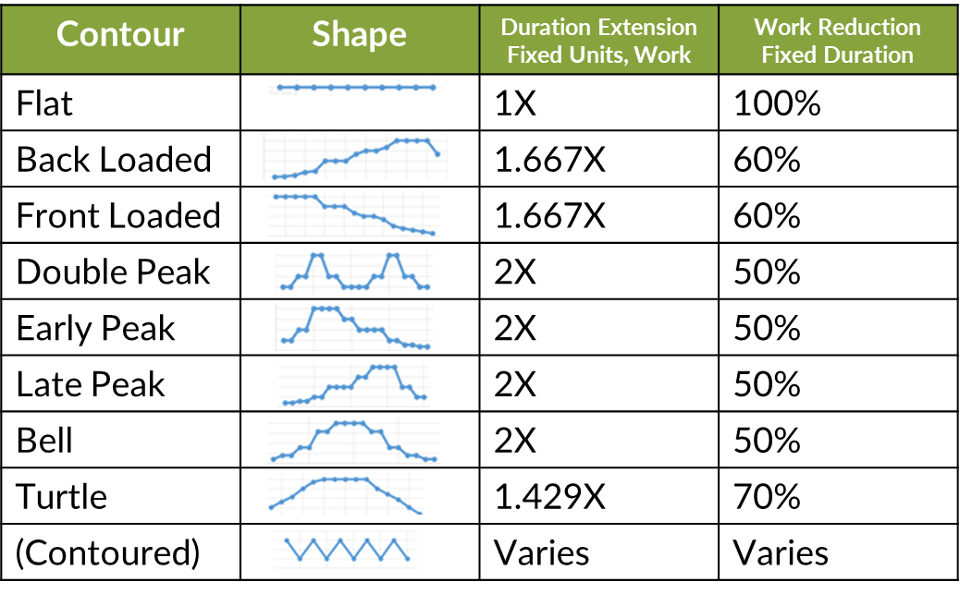
Resource Contouring
Resource assignments can be contoured
Out-of-the-box contours may impact task duration
Any distribution other than flat is considered a contour
Contours impact how task remaining hours are redistributed
Notes:
39

Slide 40
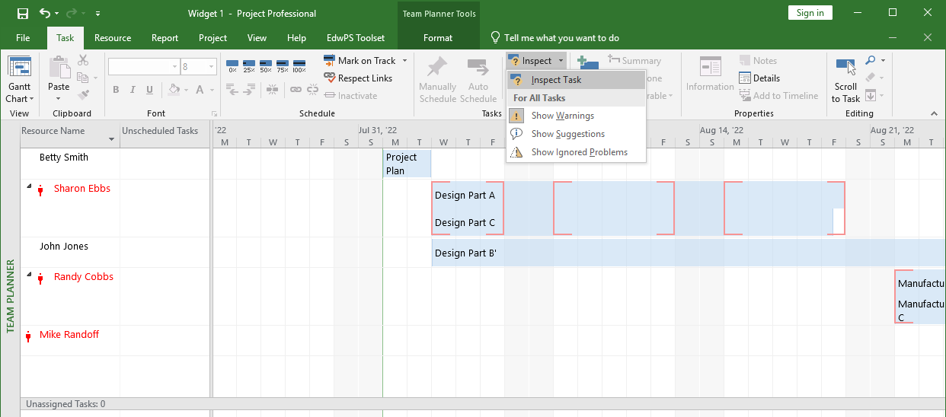
Leveling the Resource Pool on the Project
Open the Team Planner view to begin leveling the resources
Select the Task tab; then, select Inspect Task in the Inspect option drop-down within the Tasks group
Notes:
With Betty Smith selected, select Inspect Task, so that you can get a more in-depth look at the over-allocation for that task.
Note: If tasks are not visible on the right side of the EdwPS Team Planner view, then select the Task tab and select the Scroll to Task option in the Editing group.
Note: Follow the above step if Project Professional 2019 is installed.
-and-
The Edwards toolset has NOT been installed from the training book CD.
Professional
5
40

Slide 41
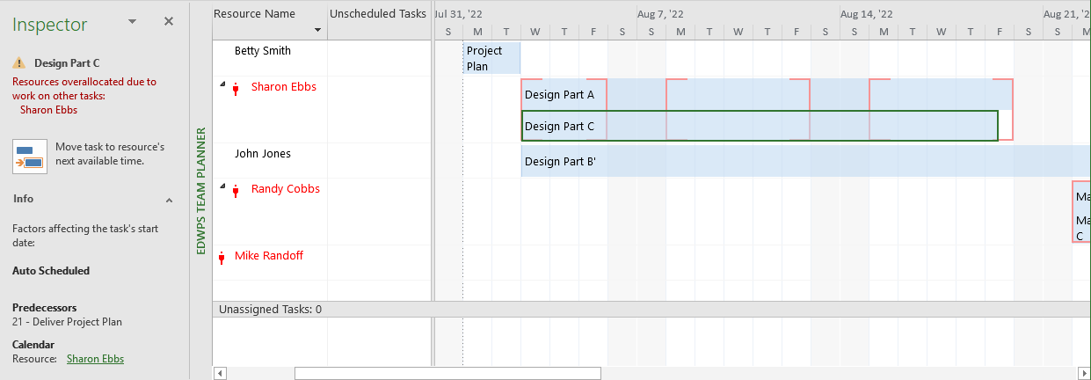
Leveling the Resource Pool on the Project
Resource leveling using the Team Planner
Options to resolve overallocations
Notes:
Note: For this exercise, we chose to reschedule Sharon Ebbs’ Design Part C task, however, other tasks (e.g., Design Part A) could have been chosen and rescheduled to see if a more favorable result could be obtained. In order to reverse the rescheduling of one or more tasks in the Team Planner, use the Undo button in the Quick Access Toolbar, located in the upper left of the application (above the tabs).
Note: Follow the above step if Project Professional 2019 is installed.
5
41

Slide 42
Cost Tracking - Cost Overview Report

Slide 43
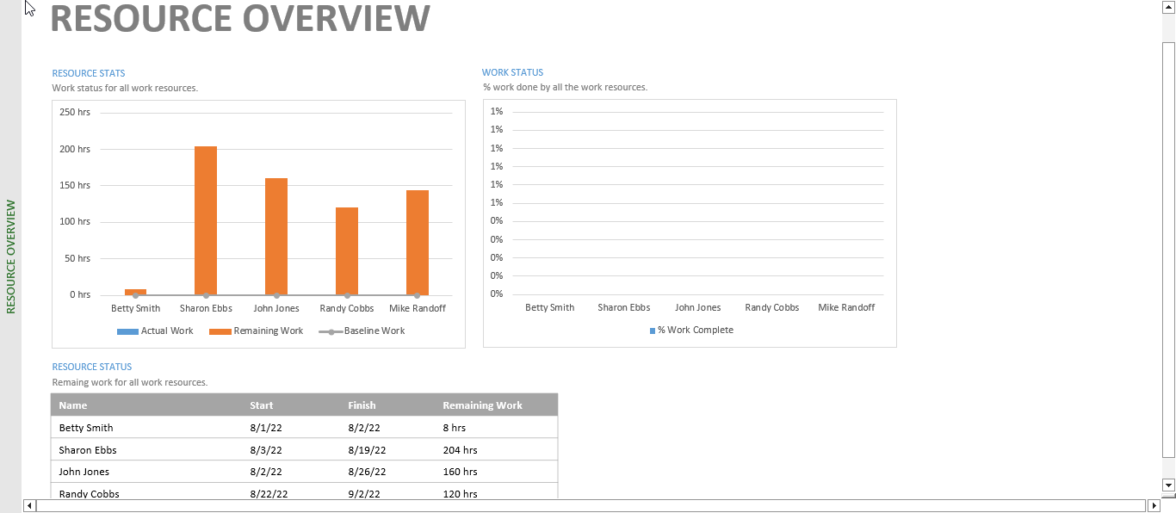
Man Hours Tracking – Resource Overview

Slide 44
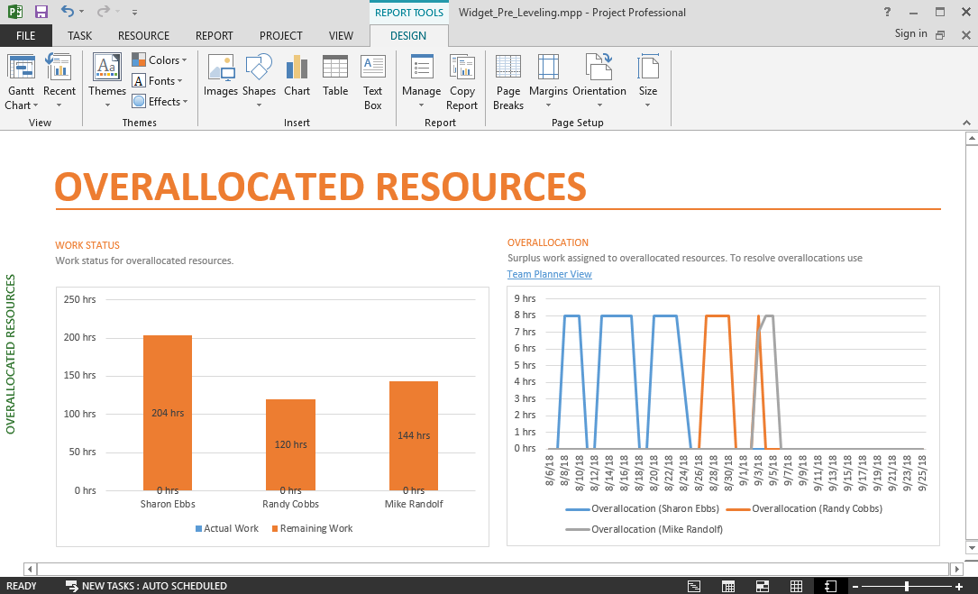
Man Hours Tracking - Overallocated Resource Report
Summarization of resource allocation issues
Notes:
44

Slide 45
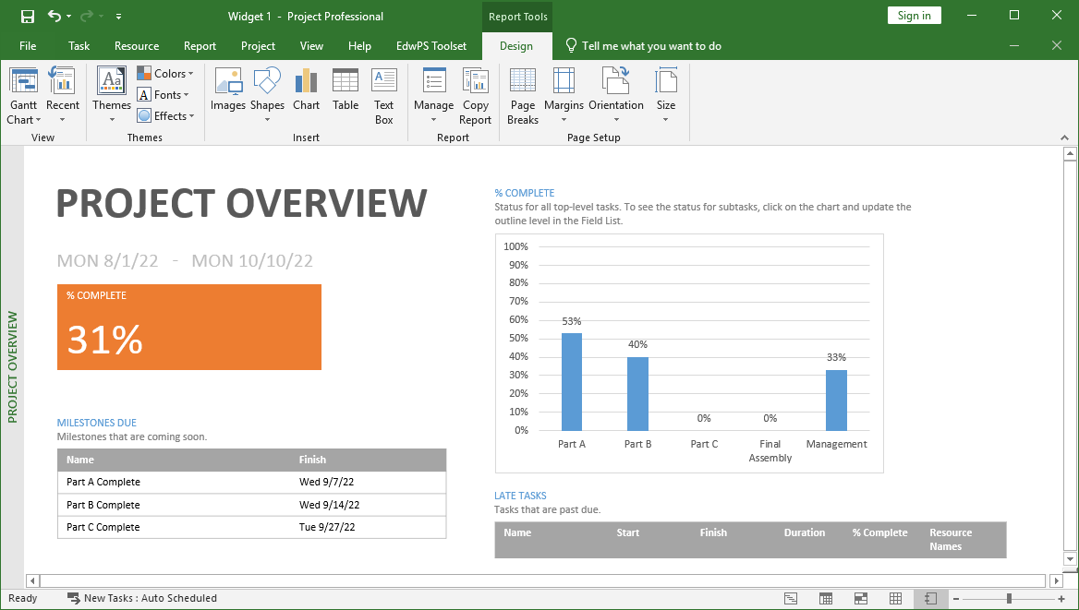
Tracking – Project Overview Report
Notes:
Burndown shows the trend of completed and remaining work over a specified time period. Burn rate provides calculations of the completed and required rate of work, based on the specified time period. In addition, a chart shows the amount of completed and remaining work that is assigned to team members. You can view the Burndown and Burn Rate report based on hours worked or number of work items that have been resolved and closed.
7
45

Slide 46
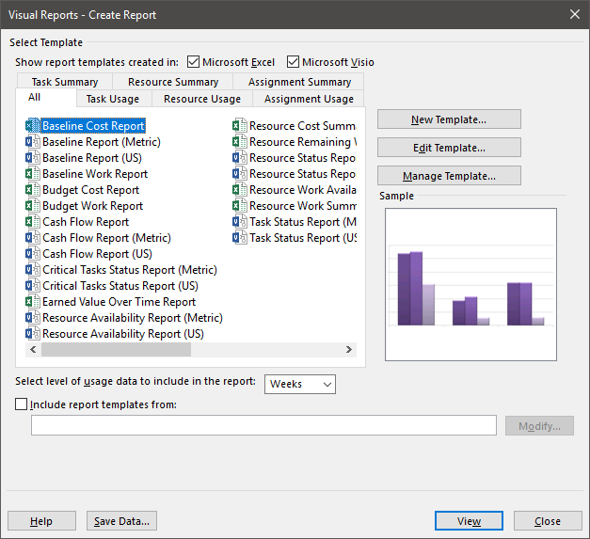
Visual Report
Select Baseline Cost Report in the All tab and click View
Step 3: Select the Baseline Cost Report
Step 4: Click View
Notes:
Note: Visio Templates will be displayed only when Microsoft Visio is installed.
7
46

Slide 47
Questions?

Slide 48
Man Hours and Cost Tracking Using Microsoft Project
Future webinar info here
Be sure to visit: mpug.com/event to register for our live webinars into 2023!
Also coming up!
Webinar info here
Notes:
Satya Narayan Dash is a management professional, coach, and author of multiple books. Under his guidance, over 2,000 professionals have successfully cracked PMP, ACP, RMP, and CAPM examinations – in fact, there are over 100 documented success stories written by these professionals. His course, PMP Live Lessons – Guaranteed Pass, has made many successful PMPs, and he’s recently launched RMP Live Lessons – Guaranteed Pass and ACP Live Lessons – Guaranteed Pass. His web presence is at https://managementyogi.com, and he can be contacted via email at managementyogi@gmail.com.

