Slide 1
Requirements Management Tips for Success
PDU Code: mpug110123
Date: 11 1, 2023
Time: 12:00 pm - 1:00 pm
Presenter Info: Chester Cox

Slide 2
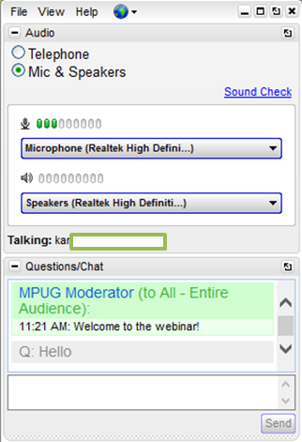
Requirements Management Tips for Success
GoToWebinar Tips
Type Questions into the “Questions/Chat” window
Collapse/expand the control panel with the orange arrow
Use the ZOOM tool on the Viewer as needed
Use the camera icon on your Viewer to take screenshots that are saved to your desktop

Slide 3
Requirements Management Tips for Success
10/15/2023
Notes:
PROJ2100 − Requirements Management
Revision Date – 3/1/2023

Slide 4
Course Description and Objectives
Description
This session will cover several techniques to effectively identify internal and external project stakeholders, methods to collect, define and organize requirements, and approaches to developing them into traceable, functional, and system requirements
Objectives
Describe types of stakeholders and means of identifying them
Create a stakeholder register
Describe multiple tools and techniques for communicating with stakeholders effectively
Transform stakeholder needs into requirements
Describe types of requirements
Define, analyze, and manage requirements
Write complete, comprehensible, and verifiable requirements
4
Notes:
4
Copyright© 2023 by Edwards Industries, LLC.

Slide 5
Why should You Care About Requirements Management?
Managing the requirements of any project is crucial for any hope of a successful outcome and can be applied to any software, business, engineering, change management, or project development
Organizations that incorporate requirements management in its process are more likely to have higher customer satisfaction
Why? These organizations repeatedly deliver higher quality results in their earliest attempts. This is due to good requirements management practices leading to:
Stakeholder identification and management
Effective requirements and needs gathering process
Traceability and scope creep prevention
Meeting customer expectations
These are just a few major objects that can make or break the success of any project

Slide 6
Importance of Requirements Management
Poor or nonexistent requirements management processes has been identified as a leading cause of project failure. Scope creep, or the lack of ability to control it, is a common cause of project cost overrun and project delay
Requirements management processes are implemented to ensure success by preventing project failure and identifying and controlling scope creep
Here are just a few common reasons that show up on various research studies conducted on why projects fail:
Incomplete stakeholder's registry
Incomplete requirements
Unrealistic requirements/expectations
Changing requirements
Poor planning
Lack of traceability (Scope Creep)

Slide 7
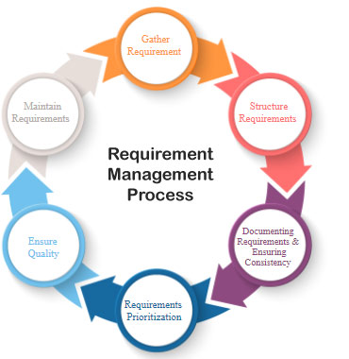
Requirements Management Plan
A good requirements management process plan includes planning, development, verification/Validation, and change management processes
The plan should include the following processes verifying that requirements are being met
Planning, gathering, defining, refining, organizing, documenting, and testing
With these processes in place, requirement changes can easily be tracked and controlled
Ultimately, requirements management helps the team understand stakeholder needs, visualize the final product, organize their efforts, and control the process with less unexpected problems

Slide 8
Why Manage Requirements
A lot can be gained from managing requirements with the right approach. For example, with change management and analysis, you can perceive the impact of a change to a requirement before the change is made. This is particularly useful for risk analysis
Initially, gathering and managing requirements can be used to:
communicate user or organizational needs
provide a solid foundation for a system or product
provide a first view of what the intended product must do
provide a clear description of how a system should perform
serve as a foundation for testing and user acceptance
provide a basis for design
provide clear goals and measurable objectives
show traceability back to the requirement sources

Slide 9
Keys to Requirements Management Success
There are common thing that can be applied to any project to ensure successful requirements management, here are a few basic tips to take into consideration
Achieve true business value
The requirements gathered must be the right requirements, ones that link back to the original project objectives, which in turn support the objectives of the business
Involve the right people
Wrong or missing stakeholders. To help identify a strong core group of stakeholders, conduct a stakeholder analysis and determine who the stakeholders are and who else should be stakeholder
Realistic expectations
Be realistic about what can be provided. Straightforward estimates, realistic deliverables, and timeframes are all essential to stakeholder expectations

Slide 10
Keys to Requirements Management Success (Cont.)
Well-Understood Requirements
Everyone involved in the project needs to be on the same page. That’s primarily the point of gathering and managing requirements. You could build the wrong project or build the right project incorrectly, either way both are bad
Are you building a duck or a bunny? Ensure everyone is seeing the same thing when managing requirements
Understanding Requirement Types
Have a good Requirements Management Plan
A requirement management plan is an essential document within a project that can be used to get feedback from your team, monitor the progress of the project and keep track of stakeholder requirements
Not all requirements are the same, there are many different types of ranging from system, stakeholder, functional, non-functional, business, etc. and should all be handled properly.

Slide 11
Who and What are Stakeholders?
Stakeholders are groups or individuals with an interest or investment in a project. They can either affect or be affected by the project
Usual stakeholders are employees, customers, investors, suppliers, communities, or governments and can be both internal and external to the organization
Common internal/external stakeholder examples are as follows:
Internal Stakeholders
Project sponsor
Project team members
Support staff
Internal customers for a project
Senior management
Functional managers
External Stakeholders
Project’s customer/client
Competitors
Suppliers
Government officials
Concerned citizens

Slide 12
How to Identify Stakeholders
Every project has stakeholders that impact or impacted by the project in a positive/negative way
Correctly identifying and managing stakeholders can mean the difference between success or failure of any project
Stakeholder management starts by asking two simple but important questions
Who could be affected by the project
Who could have an impact on the project
A good place to start identifying stakeholders is to conduct a stakeholder analysis
This analysis contains details relevant to each stakeholder such as name, organization, position, locations, project role and contact information
Stakeholder assessments are included, they will show the stakeholders major requirements, expectations and level of project influence

Slide 13
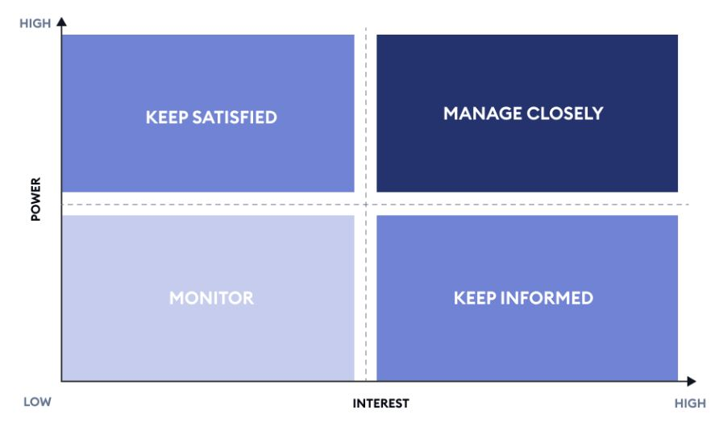
Stakeholder Analysis
Stakeholder analysis involves first devising a list of potential stakeholders and then determining which ones have the greatest investment or impact to the project
Start by gathering enough information to understand each stakeholder’s needs
Prioritizing by investment or impact can help drive key stakeholder engagement and streamline decision-making to meet objectives
Utilize a Power-Interest grid to categorize the stakeholders by importance and influence
This strategic tool is used to identify, categorize, and manage stakeholders and stakeholder interactions. Categorizing stakeholders using this matrix is a good way to manage communications and ensure stakeholder satisfaction

Slide 14
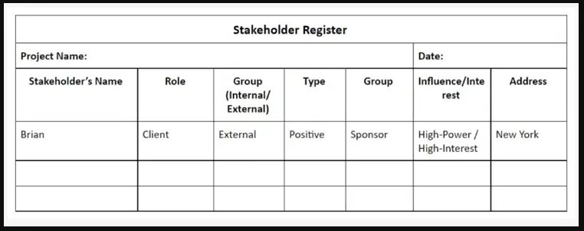
Stakeholder Registry
A registry contains information about the stakeholders, their views, and your prospective plans to engage with them
Once you have identified and organized the stakeholder's information, you may sense how sensitive this document is and classify it as a confidential document to be handled with care
Here is an example of a basic registry

Slide 15
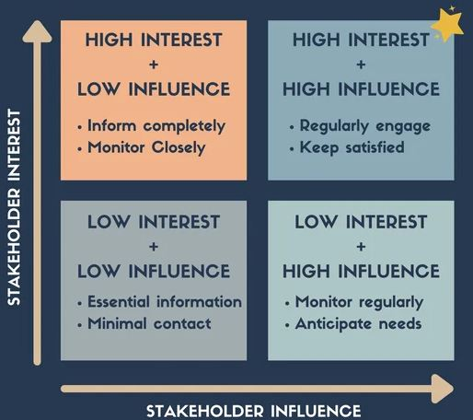
Mapping Your Stakeholders
With strategic planning, stakeholder engagement is critical. Ensure your KEY stakeholders are aligned with the strategic direction of the project
Develop a plan to engage with each stakeholder in a way that works best for them
Mapping helps prevent over communicating with low interest and influence stakeholders and to engage higher interest and influence stakeholders in greater detail
Create a Stakeholder Mapping chart
You can map your stakeholders into one of four categories
This is a visual process that charts each project stakeholder to show their influence and interest in the project
Once you’ve completed a stakeholder map you now have a guide to stakeholder engagement

Slide 16
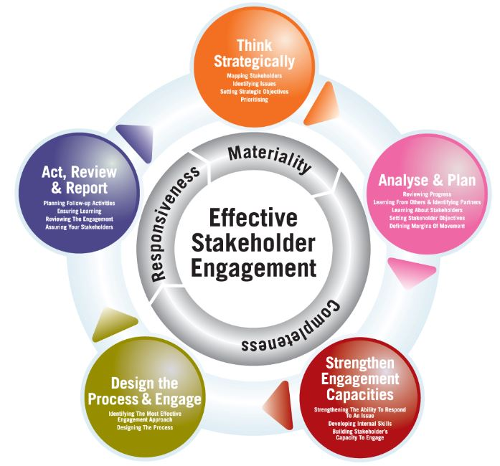
Stakeholder Engagement
Stakeholder engagement is important for successful strategic planning. It involves identifying, understanding and including stakeholders and how to communicate with them
Stakeholder engagement involves identifying and prioritizing stakeholders and deciding the best strategies for effective communication
Placement on the matrix will help identify the best approach to engage with each stakeholder
Stakeholder engagement is how you implement strategies to influence stakeholders, determine their needs and requirements and ensure they’re met
Done correctly, stakeholder engagement can prevent potential risks and conflicts

Slide 17
Communication Management Plan
An effective stakeholder communication plan allows you to receive feedback from stakeholders regarding any decision that may affect them
This is a strategy developed to better connect with stakeholders and to assess their feedback regarding project requirements and development
Primary goals of a stakeholder communication plan are:
To meet requirements and achieve objectives
To maintain or improve relationships with stakeholders who can influence the projects success
Assist in managing clients and other stakeholders
Help with overall project planning
Once you have identified and categorized stakeholders, establish the best methods of communications

Slide 18
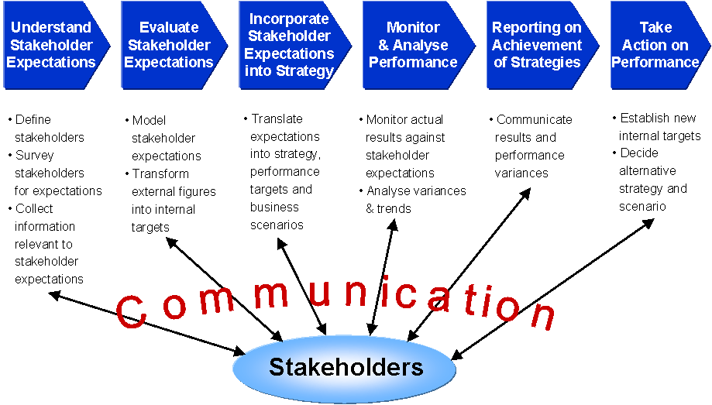
Utilizing a Communication Management Plan
Stakeholder communication is one of the most important aspects of a project
Stakeholders define weather a project is successful or not. Identifying, managing, and communicating with them will help ensure you receive their support
The communication plan will identify how frequently each stakeholder should be contacted and updated
It establishes the content of the communication and what it intends to accomplish

Slide 19
Keys to Successful Stakeholder Management
Identify ALL the stakeholders and their roles and interests in the project
This ensures that all possible stakeholders are involved in the project and have a say in decision making
Goals & expectations
Create clear goals at each life cycle stage of the project to set expectations
Stakeholders need to be clear on what they receive, will not receive, and what will happen next
Stakeholder relationships
Building strong relationships is critical for successful stakeholder management
Good relationships will help greatly when things don’t go as planned, things can go bad, and when they do, stakeholders need to know they can put their trust in you

Slide 20
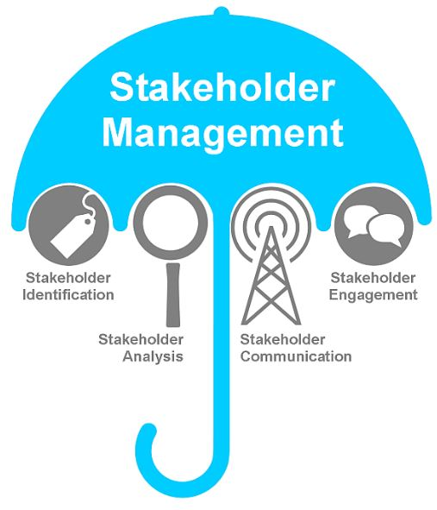
Keys to Successful Stakeholder Management (Cont.)
Check, early and often
Early stages in any project may be unclear to the stakeholders in terms of purpose, scope, risks and approach
Check with stakeholders early, and then regularly to confirm that requirements are and being met
Understand what success is
Project success means different things to different stakeholders
Determine what your stakeholder identifies as success in the context of meeting requirements

Slide 21
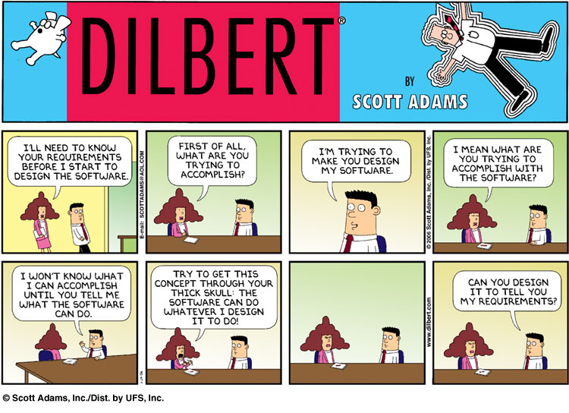
Requirements Gathering
Once you have identified and prioritized your stakeholders, you need to collect and document their requirements
There are many techniques used to gather requirements, some are:
Interviews, workshops, surveys, observations, prototypes, or user stories
Document the requirements clearly and concisely in a readable, sharable format accessible to all stakeholders, be consistent in formatting and language
Include assumptions, constraints, dependencies, and risks
Remember to get the approval and sign-off from your stakeholders on the requirements document

Slide 22
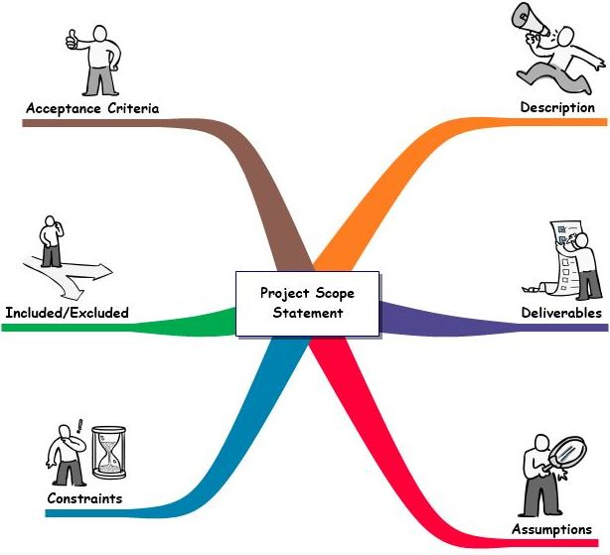
Foundation for Developing Requirements
Stakeholders must work together and define the project scope. They must understand the constraints before the determining the requirements
Without a clear Scope definition, stakeholders lack critical information needed to determine if any requirements are missing
Stakeholder needs, expectations, constraints, and interfaces are usually poorly identified, conflicting, or left out completely
When you’re translating stakeholder needs into requirements, it’s important that you clearly define the meaning behind what the stakeholders are saying
The requirements need to be specified in very significant detail

Slide 23
Transform Stakeholder Needs into Requirements
Stakeholders can be internal or external
Internal stakeholders are inside your organization. Work close with them to understand their functional and non-functional requirements
When determining a stakeholder's requirements, you must separate the needs and wants
Needs are attributes and characteristics that must be meet, these are the stakeholders functional requirements
Wants are attributes or characteristics that could bring additional value but are NOT required
The various stakeholder inputs should be collected and consolidated
Any missing information should be obtained from the stakeholder
Conflicts should be resolved as requirements are developed and prioritized

Slide 24
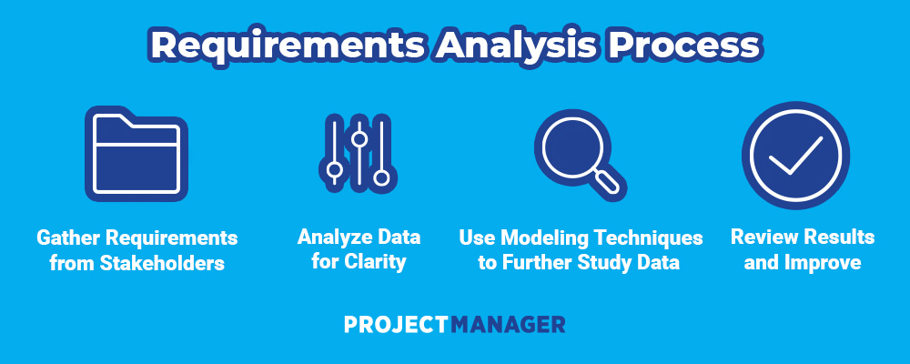
Requirements Analysis
The next step would be to conduct a Requirements Analysis on the gathered requirements
Requirements analysis are used to determine needs and expectations. It involves frequent communication with stakeholders to ensure clarity, completeness, and relevance of each requirement and to define expectations and resolve conflicts
A requirements analysis is a process that usually includes the following steps.
Understanding stakeholders
Capturing requirements
Categorize requirements
Interpret and document requirements
Finalize and get approval on requirements

Slide 25
Requirement Analysis Tools and Techniques
Requirement Analysis Techniques
Business Process Model and Notation (BPMN)
Flowcharts
Gantt Charts
Gap Analysis
Requirement Analysis Tools
Requirements analysis can be performed successfully by using the right set of tools. Here are some of the most popular ones:
Jama Software
Caliber
Visure Requirements
Orcanos
Modern Requirements
IBM Engineering Requirements Management DOORS Next
Accompa
ReqSuite
Perforce Helix RM
Pearls

Slide 26
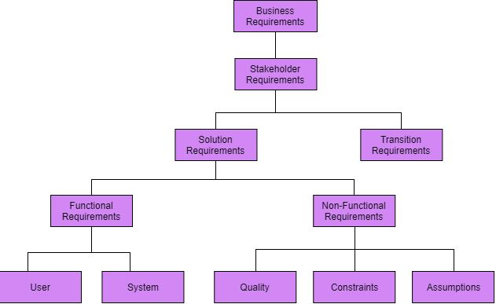
Types of Requirements
There are multiple types of requirements that are important to different stakeholders. It is important to have a mutual understanding of the different types of requirements
Project managers define the types of requirements, it is helpful to group requirements by category
Typically, requirements can fall within these basic categories
Business requirements
User or stakeholder requirements
System requirements
Software requirements
They can be divided up into subcategories
Functional requirements
Non-functional requirements

Slide 27
The Art of Writing a Good Requirement
One of the primary reasons for project failure is having poor requirements and Ineffective requirements
Writing good requirements is a combination of both skills and practice. This can appear to be a complex topic, but it’s a simple concept
Some common problems when writing requirements are:
Making bad assumptions
Writing operation (HOW) instead of requirements (WHAT)
Using incorrect terms
Too technical
Using incorrect sentence structure or bad grammar
Missing requirements
Untraceable requirements
Over-specifying

Slide 28
Prioritizing Requirements
Requirements can stack up which can become overwhelming.
Projects can have hundreds or thousands of requirements. Which requirements do you start with
Prioritizing your requirements will help gain clarity to know which ones to focus on first. Here are some questions to ask when prioritizing requirements:
What will be gained from a specific requirement
If not executed, will there be undesired consequences
What level of effort resources are needed with this requirement
Any reasons that could cause the requirement to fail
Some requirements are dependent on others
Deadlines could be connected to some requirements
Compliance with changes in laws or rules

Slide 29
Qualities of a Good Requirement
When writing a high-quality requirement, consider the qualities below. They will serve as a check-list when constructing your requirement
Clear or Understandable
Complete
Correct
Testable
Prioritized
Traceable
Achievable
A good requirement removes many headaches later in the project
Writing requirements takes practice. ask yourself, “Do I feel confident in what this requirement asks?” If you have any doubts, the requirement needs additional work
Categorized
Relevant
Concise
Unique
Conformant
Owned
Consistent

Slide 30
Keys to Successful Requirements Writing
Use specific words to express precise things
Use “shall” in stating requirements
Use “will” in stating facts
Use “should” in stating goals
Use a template for requirement statements, they give consistent structure to requirements
Use text formatting to highlight the importance of certain parts
Avoid ambiguous words like “etc.” or “and/or” they are open-ended
Practice writing requirements, it’s the only way to learn
Research past similar projects, review the requirements and how they were written
Validation. Once the requirements have been written, review them with the stakeholders and subject matter expert to gain feedback and make corrections

Slide 31
Notes:
32
Copyright© 2021 by Edwards Industries, LLC.

Slide 32
WEBINAR NAME HERE
Future webinar info here
Be sure to visit: mpug.com/event to register for our live webinars into 2023!
Also coming up!
Webinar info here

