Slide 1
Managing Competing Demands and Complexity: Prioritizing Your Time
December 6, 2023

Slide 2
Description & Objectives
Description – This session will highlight several techniques to determine what tasks to tackle first when the “to do” list is overwhelming. Wrestle your schedule back into submission by clearing away time wasting activities clogging the workday
Objectives
Discover how time management and basic scheduling can help you prioritize
Learn to differentiate between urgent and important tasks
Maximize the amount of work not done
Learn to identify work that creates the most value
Release unhealthy perceptions about being “busy”
Notes:
I’m adding the description and objectives here not only to share what I’ll be talking about, but to give you the opportunity to decide – do I need this? Is this a good use of my time? I hope that it is, but that decision isn’t mine – it’s yours.
[Read Description]
Still, we will cover some basics for organizing your day to get you started right, and some tools to help you make decisions when you just can’t or don’t want to do it all. If you get nothing else from the next 45 minutes or so, I hope this one resonates – learn how to do less stuff! Maximize the amount of work NOT DONE. We’ll talk about how prioritizing can boost the value of your time and lastly, let’s take a look at see if we are staying busy for the wrong reasons. Ready? Okay.

Slide 3
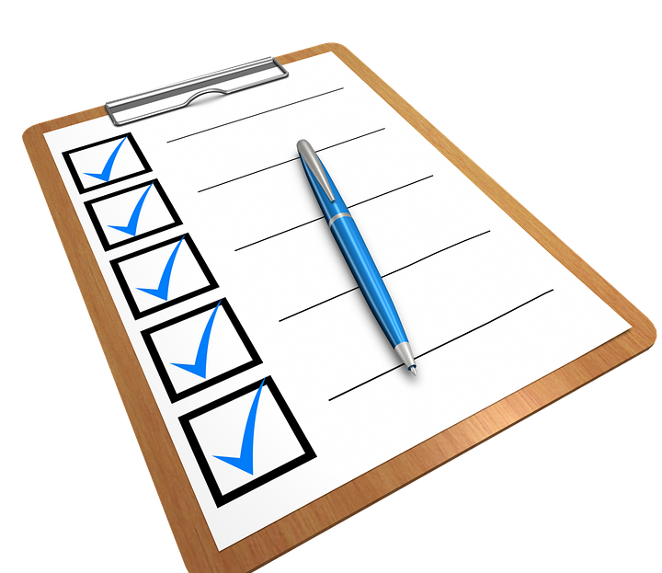
Reserve Time to Think
Take control of your schedule by blocking time each morning to sort out your day
Evaluate the items on your schedule and determine what you can eliminate, delegate, or defer
“Find time to think strategically.” Make the space for what you know really counts or the meetings will take you over...” – Tony Blair, recalling the best leadership advice he received from President Clinton
If you need to find a creative solution, review the problem and then do something else
Notes:
I learned early in my career to hold time each morning to read email, look at my schedule, and make decisions about my day. Also – coffee time is a psychological necessity. For everyone.
If you have tasks to complete that day, make sure you are holding time to work on them. Assign it to yourself at a specific time on your calendar. I guarantee it is just as important, maybe more so, than the meetings you have mapped out on Outlook.
Make sure that reserved time includes space to think. This doesn’t mean that you are blocking time to sit and do nothing – it might just mean that you do an early review and then do other things before you jump in to work on a problem to solve. Schedule your day to allow that.
I used to tell my writing students that their subconscious will help them create if they give themselves time to allow the questions to bubble in the background. This is the secret. Adam Grant has a TED talk on habits of original thinkers (I’ve added the link to the resources slide at the end of the slide deck) where he talks about the role of procrastination in the creation of breakthrough thinking. He did a study and it showed that people who jumped in right away and people who waited until the very last minute to start were less creative than the group who reviewed the task then did something else for awhile and came back to it later. This isn't about needing the pressure of a looming deadline, it's about giving your brain time to work on the problem while you walk the dog or fold laundry or drive the kids to school. Try it – it works!

Slide 4
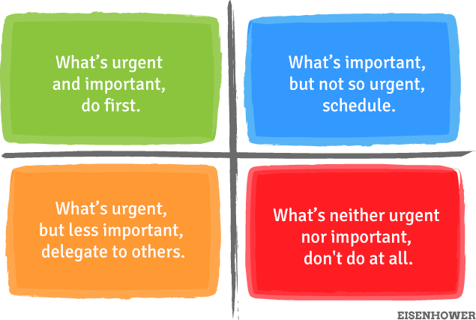
The Eisenhower Matrix
Categorize the tasks on your list into categories based on importance and urgency.
Urgent
Not Urgent
Important
Not
Important
This Photo by Unknown Author is licensed under CC BY-NC-ND
Notes:
There are two factors that determine what tasks we do – are they URGENT – meaning do they require your attention RIGHT NOW with immediate consequences, and are they IMPORTANT, meaning do they help you achieve long-term goals. Because Important tasks might not have a clear deadline, and the consequences might not appear right away, it’s easy to tell yourself that you’ll “do it later.” Sometimes, though – later becomes never.
So let’s go through the exercise. First make a list of tasks. Or pull out that list I know you already have tucked away somewhere, maybe on a sticky note.
Then assign them to a quadrant on this matrix.
Items that are Important and urgent: (project deadlines, medical emergencies, problems) Do them now
Items that are important but not urgent – (health, relationships) make a schedule to do them as soon as possible.
Items that are urgent but not important (text messages, random phone calls, unimportant emails and other things that are probably important to someone else) reschedule or delegate
Lastly, the items not important and not urgent – like watching TV or checking Facebook, do later or avoid completely
Here is the benefit of this exercise – those items that you determine are important, but not urgent MUST GET SCHEDULED. Put them on your calendar. Maybe you are thinking to yourself – hey, my important list is about spending time with my boo or my kids – not stuff I would put on my calendar like a meeting. PUT IT ON YOUR CALENDAR. Schedule date night. Schedule Saturday movie matinee with the kids, schedule weekend gossip brunch with your girls. These things are important and should not fall victim to falling through the cracks in the middle of all the urgent stuff coming at you. Also, having something fun or nurturing or exciting on your calendar can serve as a mental life preserver – a thing to look forward to, to anticipate. Your reward for focusing on the other stuff that has to get done until then.

Slide 5
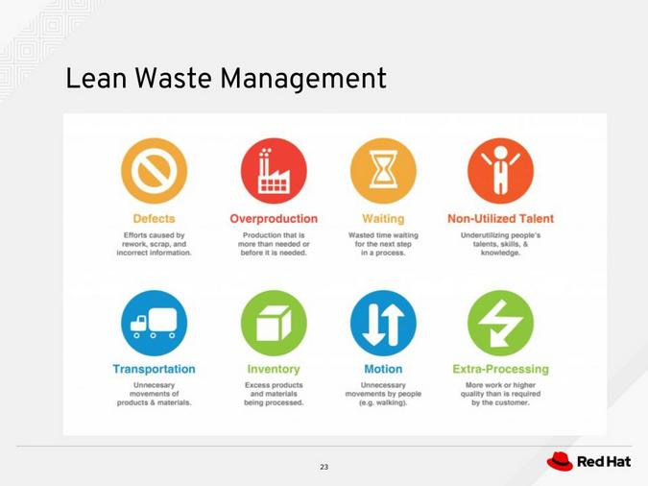
Get Lean!
"Simplicity — the art of maximizing the amount of work not done — is essential."
Agile Manifesto
Notes:
This is not about making time for the gym. Although if that is important to you, definitely put it on your schedule. This is something else.
Maximize the amount of work NOT DONE. Jeez, did you just say that in front of your boss? Yup. This is where I double down by saying that you should all also maximize the work not done by your teams too.
Clear the nonsense. Make things convenient to knock out when you can. Build in efficiencies. Reward productivity, not "busyness" - more on that in a minute. I'll give you an example. I worked with a group who had to review applications for a high profile scholarship tied to the mission of the university and program we supported. This was for a full scholarship for a graduate program, so many people applied. The applications were divided and distributed across the team. There were hundreds of them. They had to be ruled in or out on basic qualifications, and if in, reviewed by a second person, then passed on to a smaller panel of decision makers as recommendations. Imagine – lists of application essays that team members had to read and then send to someone else to read, then send to someone else. Ugh.
But what if we could get rid of some of those cumbersome steps? What if we scheduled a working session in a conference room, where qualified applicant could immediately be shared with a college and ruled in or out with no emails or lists? What if we blocked some time, ordered some pizza and knocked it out all together? Not a meeting, just a space free of distractions to read, categorize, collaborate, and make decisions – together. What used to take weeks and weeks of drudgery could get done in a day.

Slide 6
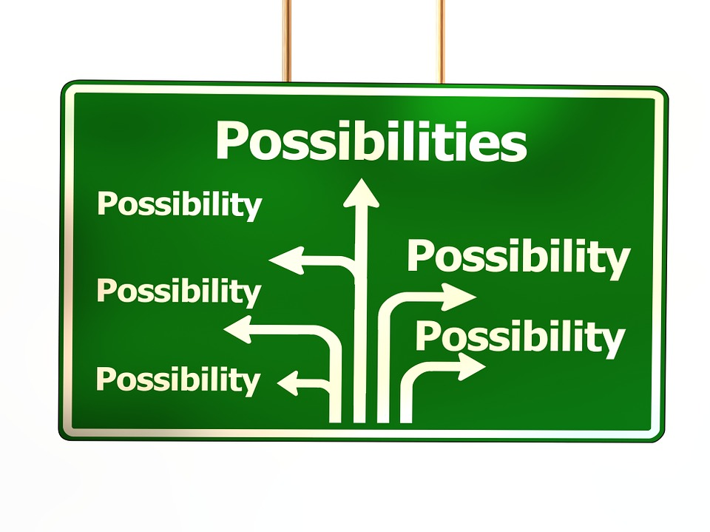
Applying the Pareto Principle
The point of the Pareto principle is to recognize that most things in life are not distributed evenly. Make decisions on allocating time, resources, and effort based on...
Instead of spending 1 hour drafting a paper/blog post you’re not sure is needed, spend 10 minutes thinking of ideas. Then spend 50 minutes writing about the best one
Instead of agonizing 3 hours on a single design, make 6 layouts (30 minutes each) and pick your favorite
Rather than spending 3 hours reading 3 articles in depth, spend 5 minutes glancing through 12 articles (1 hour) and then spend an hour each on the two best ones (2 hours)
Notes:
You probably know the Pareto Principle as the 80/20 rule. I took these examples from an article on betterexplained.com, but I think it really shows how this can apply to making smart decisions about your time. Let's look at these -
My advice – KEEP THE LIST! You might come back to it, but definitely decide on a direction and work it through.
For the second suggestion – how many of you have had a plan about what could be done and then you share it and the others make that Ummmm face. Also, I think it's in the PM DNA to have backup ideas for basically everything. If you've spent all your time on one idea, you will have a harder time modifying or scrapping it if it doesn't meet the needs or appeal to your client or your spouse. One of my favorite expressions is "Don't hold on to a mistake just because you spent so much time making it."
The last one has the best of both worlds – you have a good article and a good backup article. Should you need to go back to the well, you've at least skimmed them so you won't flounder too much.

Slide 7
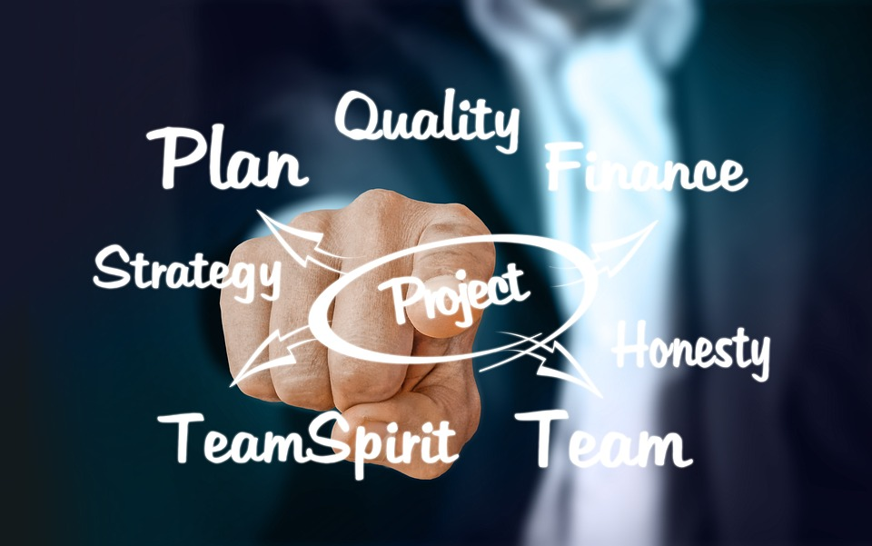
Applying the Pareto Principle (continued)
These techniques may or may not make sense – the point is to realize you have the option to focus on the important 20%
Lastly, don’t think the Pareto Principle means only do 80% of the work needed
It may be true that 80% of a bridge is built in the first 20% of the time, but you still need the rest of the bridge for it to work
It may be true that 80% of the Mona Lisa was painted in the first 20% of the time, but it wouldn’t be the masterpiece it is without all the details
The Pareto Principle is an observation, not a law of nature.
Notes:
You still have to finish the work. Details matter for sure, but figure out your direction before you go making road trip mix tapes. That's a throwback for my peeps out there. Those of you born after 1990 can google the struggle of the cassette mixtape. And what a cassette is.

Slide 8
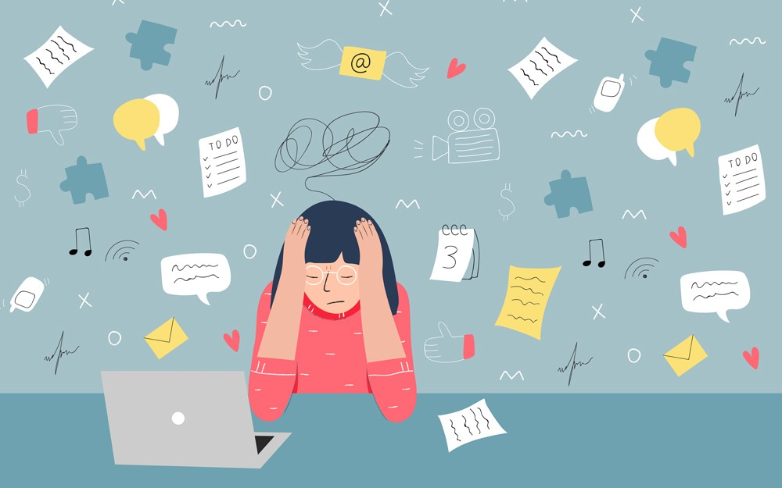
Are You Busy?
There is a connection between being busy at work (even overworked) with self-worth and perceptions of higher status
You might be staying busy to avoid painful feelings or situations
Busy versus Productive
Work-Life Balance
This Photo by Unknown Author is licensed under CC BY-NC
Notes:
Are you constantly busy?
Individuals who are busy by choice may feel needed, in demand, and important, thus elevating their feelings of self-worth.
If you're super busy, you are unable to focus on what might be bothering you or causing you discomfort beneath the surface. I’ve gotten busy to keep my mind off things for sure. “Bury yourself in work” becomes a strategy if the downtime is difficult or painful. It can become a place to hide. How many of you “stress clean?” Or work ahead to “get on top of things.” Or do a little extra research that no one asked for just in case it comes in handy? DO you like being the member of the team that gets stuff done? That always steps up?
Being busy and being productive can often be confused with one another. If you are busy, you may have a lot on your plate, but this doesn't necessarily mean you are productive, or using your time efficiently. Being productive means being able to complete a task or get something done. You do not need to be busy in order to be productive.
Being busy has to do with how you spend your time, where productivity has more to do with what you accomplish.
If your work-life balance is thrown off, you may experience burnout, feeling overworked, exhausted, and disconnected from your social and/or family life. Poor work-life balance may also lead to chronic stress, which can impact your mental health as well as your physical health.
If you are unable to complete tasks or uphold the many obligations you have dedicated yourself to, you may end up feeling guilty, or as if you've let yourself of others down. If you derive self-worth through being productive and completing tasks, feeling as if you're falling short can impact your perception of yourself.
Being overly busy and exhausted may lead to an increase in stress and/or decreased self-esteem. This may trigger more serious mental health disorders including anxiety disorders, depression,

Slide 9
The Cure for Busyness
Everyone will have their own idea of what being too busy means to them
It is important to prioritize your health and wellness, especially when you feel overworked, overwhelmed, or burned out
Although it may feel difficult to shift your priorities and your time, doing so may lead to increased mental and physical well-being, as well as more connected relationships with your loved ones
You deserve time for yourself, whether a full vacation or mini breaks during the day
Doing so is an important reminder to yourself that you are a worthy and valuable individual!
Notes:
These tips can be found at verywellmind.com I’ll post links at the end so you can go back and take a look. I think the takeaway here is to evaluate what your perceptions of “important” are when it comes to prioritizing your day. Also, think about how you can break up your work. For example, I usually check messages or make lists very, very early in the morning, still in my pajamas, then go get coffee or more coffee, or breakfast, then come back to my office to jump back in again. My "eight hours" are not always in a row. But that time in the middle still has me thinking about how to strategize my day.

Slide 10
The Cure for Busyness Tips
Practice mindfulness
If possible, plan a vacation or staycation (and don't fill it with activities) so you can recharge
Make it a priority to spend time with your loved ones
Take small moments every day to appreciate yourself
Set boundaries with others and remind yourself that it's okay to say "no"
Remind yourself that your self-worth does not come from being productive or busy
Set reminders or post notes reminding you to breathe and take time for yourself
Notes:
These tips can be found at verywellmind.com I’ll post links at the end so you can go back and take a look. I think the takeaway here is to evaluate what your perceptions of “important” are when it comes to prioritizing your day.

Slide 11
The Cure for Busyness Tips (continued)
Set appropriate expectations for yourself when and how much you can comfortably take on; this may change over time
Connect with a professional if you are having trouble with acts of daily living or notice your overall quality of life has decreased
If you use busyness as a tool to avoid unpleasant thoughts or feelings, try to determine what you are uncomfortable facing
If this seems too overwhelming, seek a professional to support you
Schedule work/busy time and free time in chunks
Always make sure you leave time for yourself throughout the day, even if it's just for a small break, and deliberately disconnect
Notes:
These tips can be found at verywellmind.com I’ll post links at the end so you can go back and take a look. I think the takeaway here is to evaluate what your perceptions of “important” are when it comes to prioritizing your day.

Slide 12
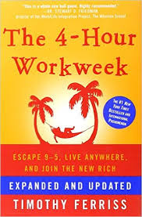
What’s Next?
Tim Ferriss - 3 Stratgies for Prioritization
Optimize for skills and relationships (even if the project fails, will I develop skills past that failure?)
Which of these (goals/tasks) would make the rest easier? (Not all priorities are equally weighted)
Excitement!! Which one are you constantly thinking about?
Notes:
Tim Ferris, the author of the 4 hour work week, shares three considerations when making decision about what to work on next. I’m not advocating for quitting here – but I think he has some good ideas about prioritization
First – will the task build skills and relationships that will last beyond the task itself? If so, it’s a win-win Sometimes, tasks will help you build connections with colleagues, learn new things, and strengthen the team. Have you ever felt like - "Hey it doesn't matter what you throw at us my team can handle it!"
Second – There may be a task on the list that will either make the others easier or no longer needed – this goes back to the 80/20 rule
Lastly – what excites you? Is there a task that keeps coming back to mind? Follow that thread. If you get the chance to love what you do – definitely do that!

Slide 13
Let’s Wrap This Up (I respect your time!)
Block your own schedule to make sure you have time to do your work, instead of spending all your time in meetings talking about doing your work
Differentiate between urgent and important tasks. If it feels like you have too many important tasks, run the Eisenhower Matrix again on just those and see what might be done later or not at all
Speaking of – maximize the amount of work not done without guilt! Eliminate time wasters
Learn to identify work that creates the most value – spend time on what will give you the most benefit understanding that all tasks are not weighted equally
Release unhealthy perceptions about being “busy” and focus more on being “productive”
Notes:
So, let’s review!

Slide 14
Resources
The Eisenhower Matrix
How Constantly Being Busy Affects Your Well-Being
Understanding the Pareto Principle (The 80/20 Rule)
https://agilemanifesto.org/
Tony Blair: Finding Time to Think Strategically
Tim Ferriss - 3 Strategies for Prioritization
The Surprising Habits of Original Thinkers
https://www.leecockerell.com/
Notes:
Here are some links to web pages or youtube videos for more information on the topics we discussed today. The one at the bottom – LeeCockerell.com is the web page of a Disney exec who used to teach time management classes for cast members when he was a Parks VP. I took his class in the mid 90s and I still use those principles today. Interestingly, I also worked with his son Dan and now both are retired from Disney and run their own consulting firm. It’s a Small World After All. See what I did there?

Slide 15
Thank you!

