Slide 1
Understanding “Driving Slack” and its Uses
Kenny Arnold
Chief Information Officer, Structured Solutions Incorporated
2023-12-13
Leading Project Scheduling Solutions

Slide 2
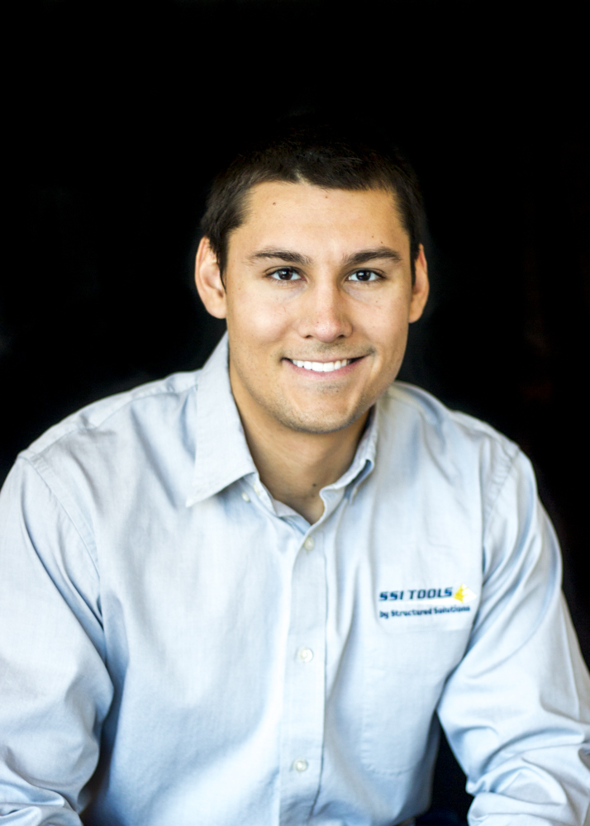
About Me
Arizona Native
Graduate of Arizona State University
Started career doing scheduling work for Orbital Sciences, which was acquired by Northrop Grumman
Currently serves as the Chief Information Officer of Structured Solutions Incorporated
2

Slide 3
Learning Objectives
Understand the concept of “Driving Slack” and how it’s different than Total Slack and Free Slack
Understand how Driving Slack can be used to calculate a Driving Path
Understand how SSI’s Dependency Analysis Tools Use Driving Slack to help analyze dependencies

Slide 4
What is Driving Slack?
Driving Slack is the amount ofSchedule Flexibility a task has before it begins to drive a Focus Point.
Schedule Flexibility = the amount of time that a task can be delayed
Focus Point = any task in the schedule chosen by the user.
Driving Slack ≠ Free Slack
Driving Slack ≠ Total Slack
Driving Slack is not calculated by MS Project.

Slide 5
Why is Driving Slack Important?
The calculation of Driving Slack is the most accurate way to calculate the project’s Critical Path or any Driving Paths.
Project’s Critical Path = the longest chain of tasks that drive the latest task/milestone in the schedule.
Driving Path = the longest chain of tasks that drive any task/milestone in the schedule.
Other methods of calculating these paths that rely on Total Slack or Free Slack are unreliable.

Slide 6
Total Slack and Free Slack
Total Slack is the amount of schedule flexibility any given task has to any tasks within its work stream that have a deadline set or the end item of the schedule.
Total Slack was not designed to be calculated to a focus item. Here are things that factor into the Total Slack Calculation:
The Project End Date
Deadlines
Elapsed Duration
Constraints
Task Calendars
Resource Calendars
Free Slack is the amount of schedule flexibility any given task has to its nearest successor.
This is different than Driving Slack because a task’s nearest successor may be completely unrelated to or share no dependencies with the focus item.

Slide 7
How is Driving Slack Calculated?
2023
Dec-11
Dec-12
Dec-13
Dec-14
Dec-15
Dec-16
(2023-12-15) Focus Point
Milestone

Slide 8
How is Driving Slack Calculated?
2023
Dec-11
Dec-12
Dec-13
Dec-14
Dec-15
Dec-16
(2023-12-11) - Predecessor 1 (SS)
Predecessor 2 (FS) - (2023-12-12)
Predecessor 3 (FS) - (2023-12-14)
(2023-12-15) Focus Point
Task
Milestone

Slide 9
How is Driving Slack Calculated?
2023
Dec-11
Dec-12
Dec-13
Dec-14
Dec-15
Dec-16
(2023-12-11) - Predecessor 1 (SS)
Predecessor 2 (FS) - (2023-12-12)
TS = 1
Predecessor 3 (FS) - (2023-12-14)
DS = 0
(2023-12-15) Focus Point
DL – (2023-12-16)
Task
Milestone

Slide 10
How is Driving Slack Calculated?
2023
Dec-11
Dec-12
Dec-13
Dec-14
Dec-15
Dec-16
(2023-12-11) - Predecessor 1 (SS)
DS = 2
Predecessor 2 (FS) - (2023-12-12)
Predecessor 3 (FS) - (2023-12-14)
(2023-12-15) Focus Point
Task
Milestone

Slide 11
How is Driving Slack Calculated?
2023
Dec-11
Dec-12
Dec-13
Dec-14
Dec-15
Dec-16
(2023-12-11) - Predecessor 1 (SS)
DS = 2
Predecessor 2 (FS) - (2023-12-12)
Predecessor 3 (FS) - (2023-12-14)
FS = 1
(2023-12-15) Focus Point
Task
Milestone

Slide 12
How is Driving Slack Calculated?
2023
Dec-11
Dec-12
Dec-13
Dec-14
Dec-15
Dec-16
DS = 4
(2023-12-11) - Predecessor 1 (SS)
Predecessor 2 (FS) - (2023-12-12)
Predecessor 3 (FS) - (2023-12-14)
(2023-12-15) Focus Point
Task
Milestone

Slide 13
How is Driving Slack Calculated?
2023
Dec-11
Dec-12
Dec-13
Dec-14
Dec-15
Dec-16
DS = 4
(2023-12-11) - Predecessor 1 (SS)
FS = 0
Predecessor 2 (FS) - (2023-12-12)
Predecessor 3 (FS) - (2023-12-14)
(2023-12-15) Focus Point
Task
Milestone

Slide 14
How is Driving Slack Calculated?
2023
Dec-11
Dec-12
Dec-13
Dec-14
Dec-15
Dec-16
(2023-12-11) - Predecessor 1 (SS)
Predecessor 2 (FS) - (2023-12-12)
Predecessor 3 (FS) - (2023-12-14)
(2023-12-15) Focus Point
Task
Milestone

Slide 15
How is Driving Slack Calculated?
2023
Dec-11
Dec-12
Dec-13
Dec-14
Dec-15
Dec-16
DS = 0
Task Y (FS)
DS = 0
Task X (FS)
Predecessor 3 (FS) - (2023-12-14)
DS = 0
(2023-12-15) Focus Point
Task
Milestone

Slide 16
Questions?

Slide 17
Thank you.
Kenny Arnold
480-234-9029
kenny.arnold@ssitools.com
Leading Project Scheduling Solutions

